Slide 1


Innovative Safety Initiative Award 2015
Foundation for Home Ownership Scheme Developments at
Hin Tin Street Shatin Area 31 (HKHA Contract No.: 20120604)
Health Care Plan
Establish a comprehensive health care plan to launch and implement a series of health care programmes on site.
To prevent and minimise the risks which are possibly incurred from latent diseases.
To provide suitable health care facilities on site as well as health information to raise workers’ awareness of personal health and health issues at work.

Slide 2

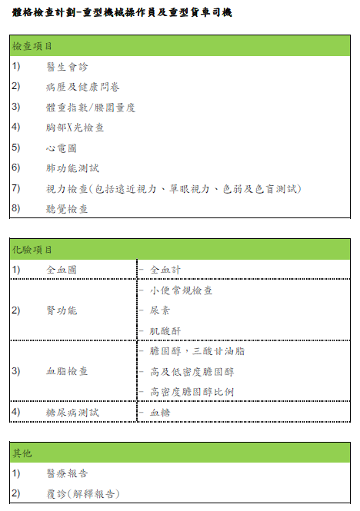
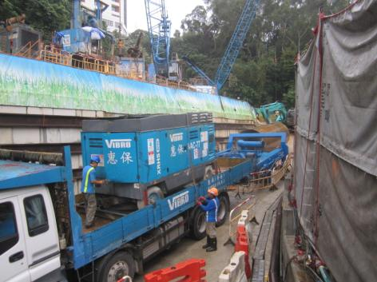
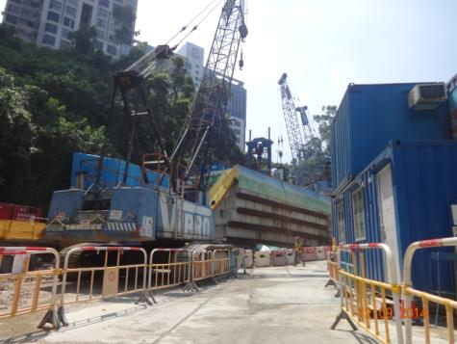
Medical Check Up Scheme for Heavy Plant Operators
To ensure body fitness of heavy plant operators (including Crane operator and Heavy goods truck driver), a medical check up scheme is arranged for them in order to detect latent health disease at an early stage.

Slide 3
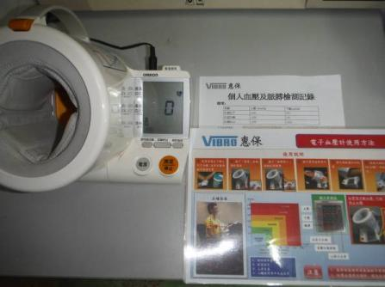
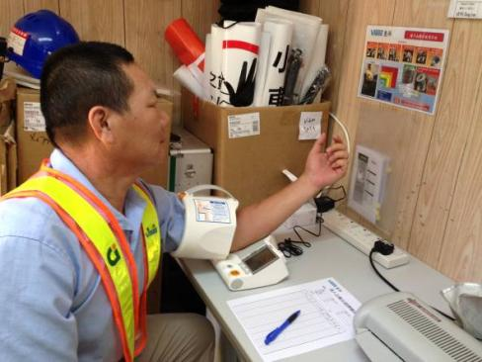
Blood Pressure Check on Site
Periodical blood pressure check is established on the site, for those heavy plant operators in daily basis and for other workers on their volunteer basis, in order to detect potential hypertension early and also to raise workers’ awareness of personal health.

Slide 4
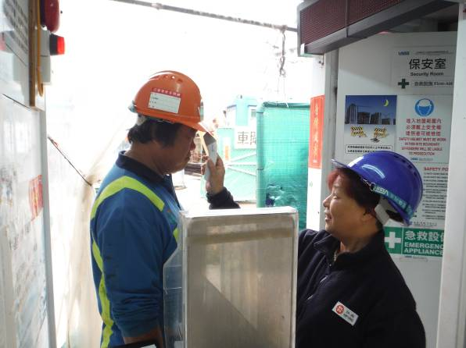
Monitoring of Body Temperature
Daily body temperature check before entering into the site is arranged for influenza pandemic to early detect and segregate the persons with fever and respiratory symptoms and therefore to minimize the risk of spread of influenza.

Slide 5
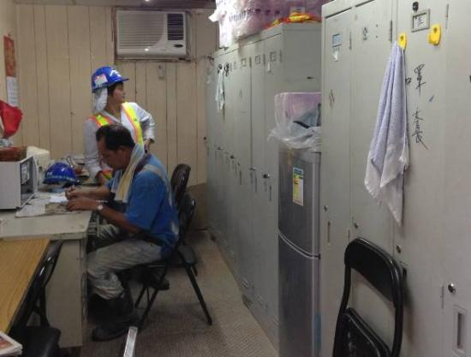
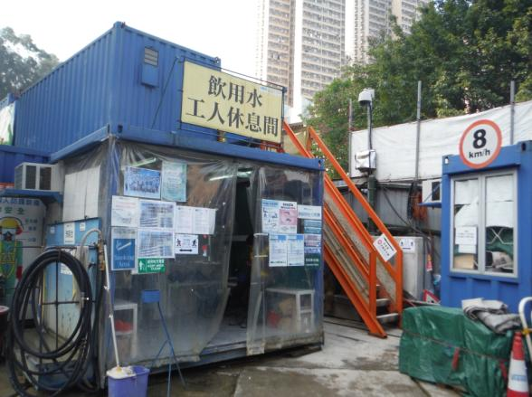
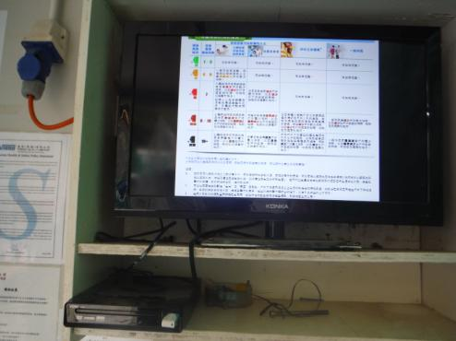
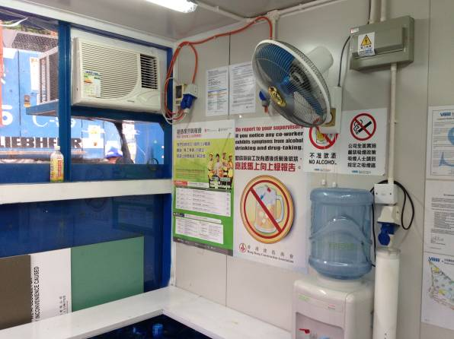
Provision of Rest Facilities
Rest areas facilities including provision of container type rest accommodation and sheltered type rest kiosk are further enhanced.

Slide 6
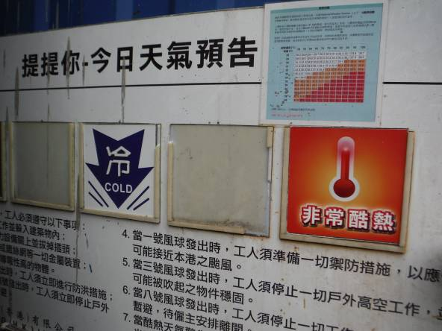
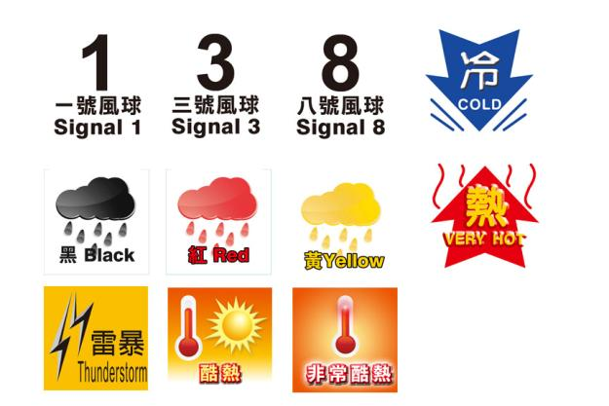
Health Promotion and Information
Weather notice board is set up on the site to notify weather warning such as hot weather (with reference to the NOAA’s National Weather Service Heat Index) and cold weather warnings etc. to workers.

Slide 7
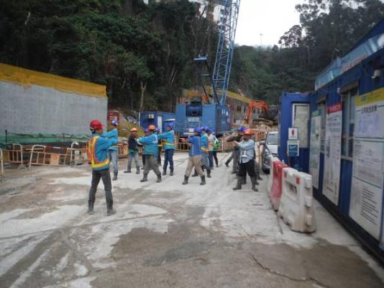
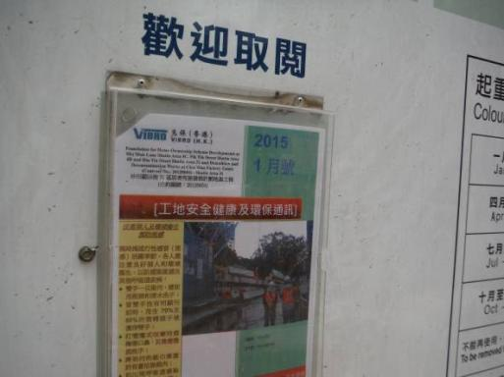
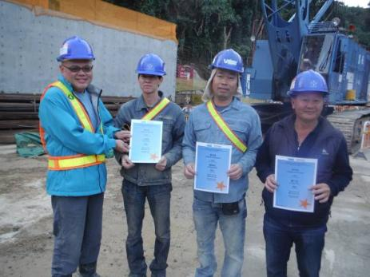
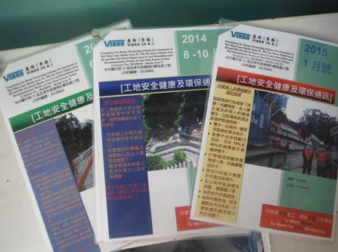
Health Promotion and Information
Update health information is communicated and shared with workers via daily morning brief and exercise, tool-box talk, in-house OSH newsletter, and incentive scheme.

Slide 8
Innovative Safety Initiative Award 2015
Foundation for Home Ownership Scheme Developments at
Hin Tin Street Shatin Area 31 (HKHA Contract No.: 20120604)
~ END ~
Thank You!

