Slide 1

Using Smartphone to carry out Risk Assessment
HY/2012/07 – Tuen Mun Chek Lap Kok Link – Southern Connection

Slide 2
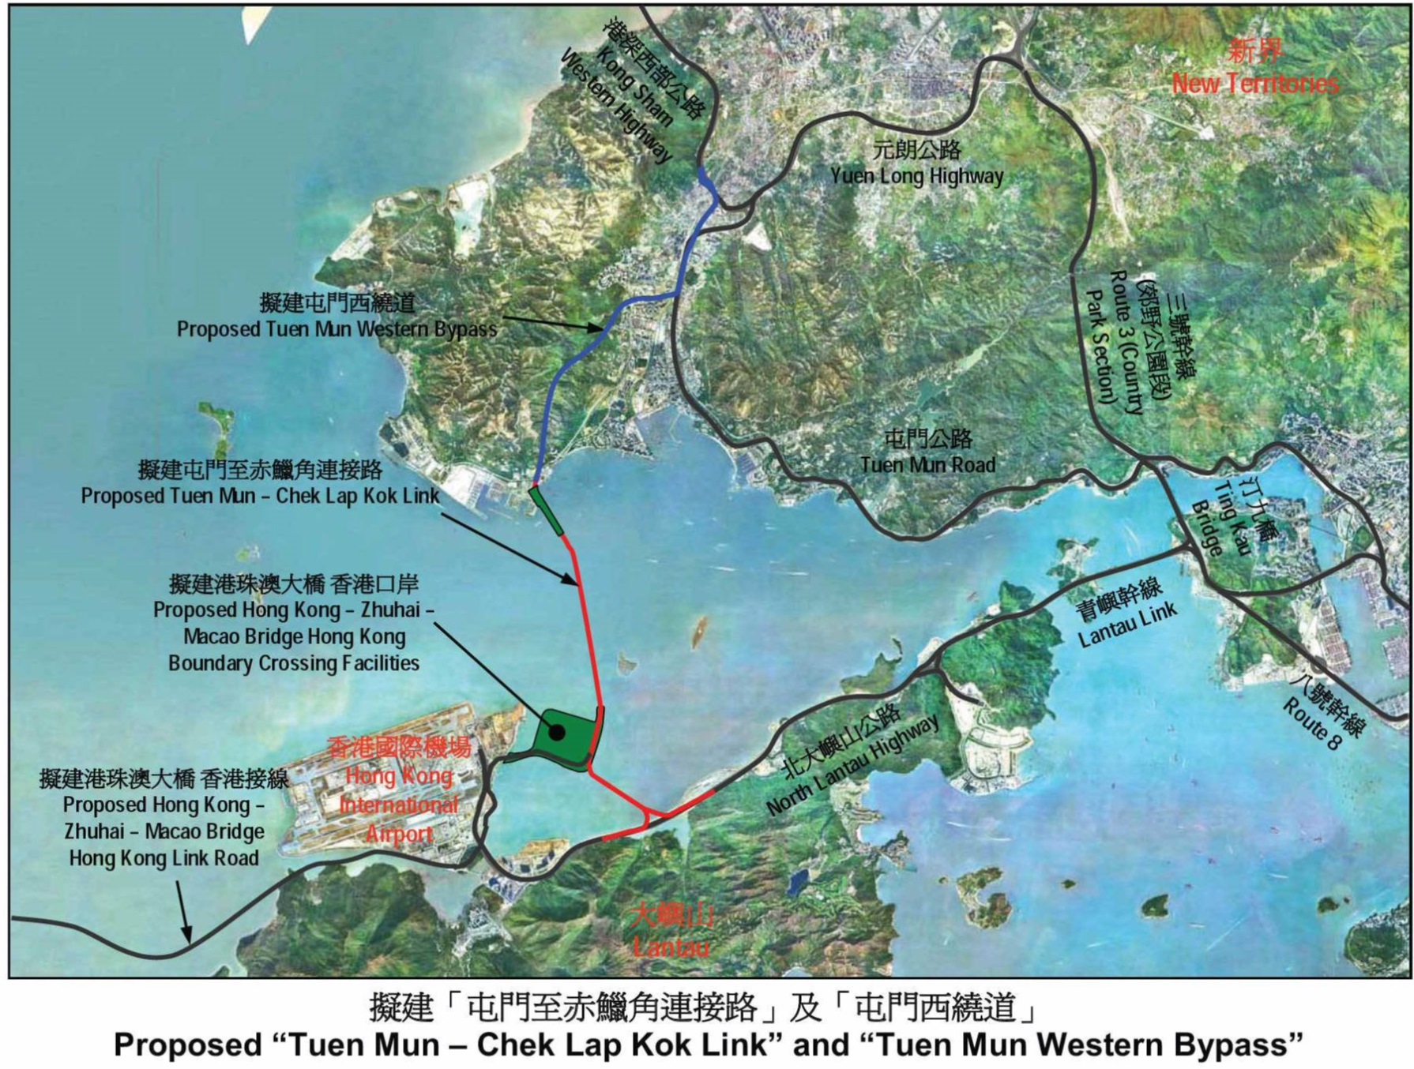
Site Location
Contract No. HY/2012/08
Northern Connection
Sub-sea Tunnel
Contract No. HY/2012/07
Southern Connection
Viaduct Section

Slide 3
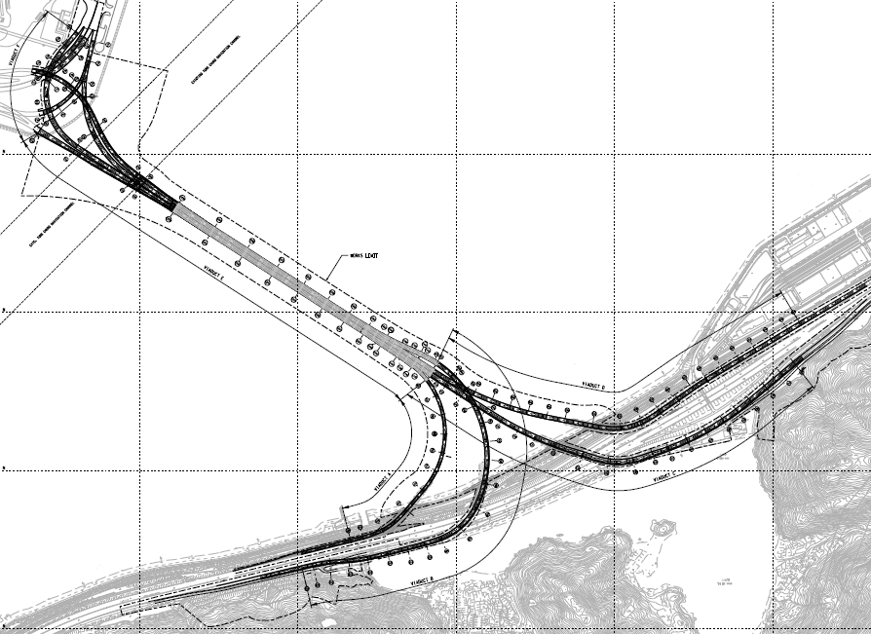
Scope of Works
VIADUCT F3, F4 & F5
VIADUCT F1 & F2
VIADUCT E5, E6, E7 & E8
VIADUCT E1
VIADUCT E2
VIADUCT D
VIADUCT A
VIADUCT C
VIADUCT B

Slide 4
Scope of Works
Viaduct | Nos. of Piles | Nos. of Piers | Nos. of Span | Nos. of PC Segments
A | 54 | 11 | 11 | 185
B | 148 | 19 | 18 | 396
C | 120 | 25 | 20 | 358
D | 158 | 25 | 19 | 457
E1 | 15 | 8 | 8 | 196
E2 | 46 | 18 | 18 | 507
E5, E6, E7 & E8 | 70 | 14 | 15 | 526
F1 & F2 | 17 | 8 | 6 | 190
F3, F4 & F5 | 57 | 14 | 12 | 305
Total | 685 | 142 | 127 | 3120

Slide 5
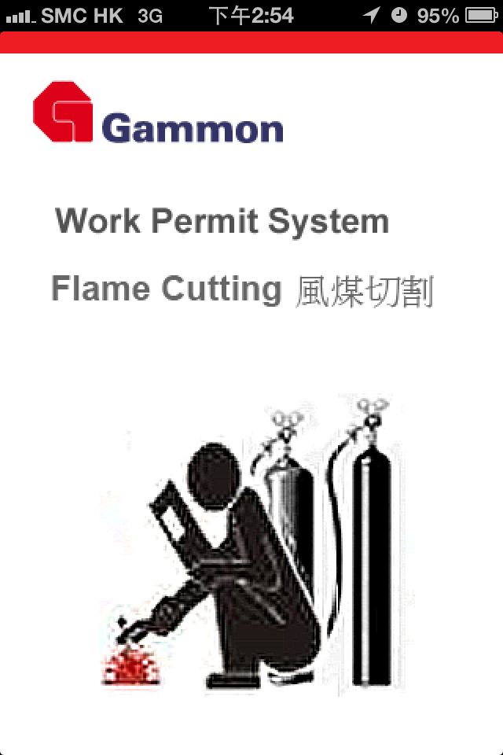
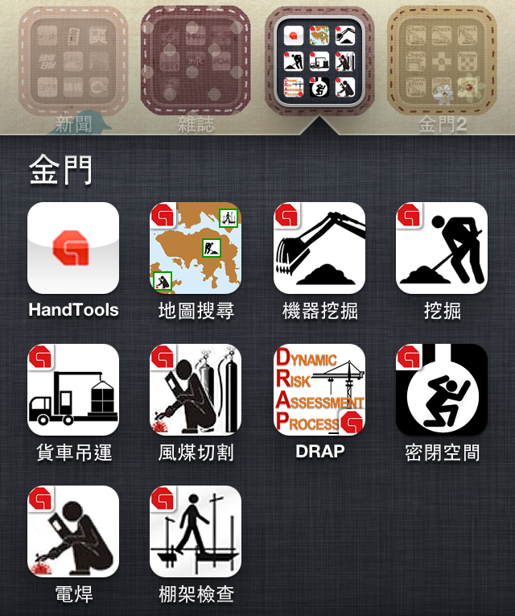
STEP 1 & 2 – SELECT DISTRICT AND LOCATION

Slide 6
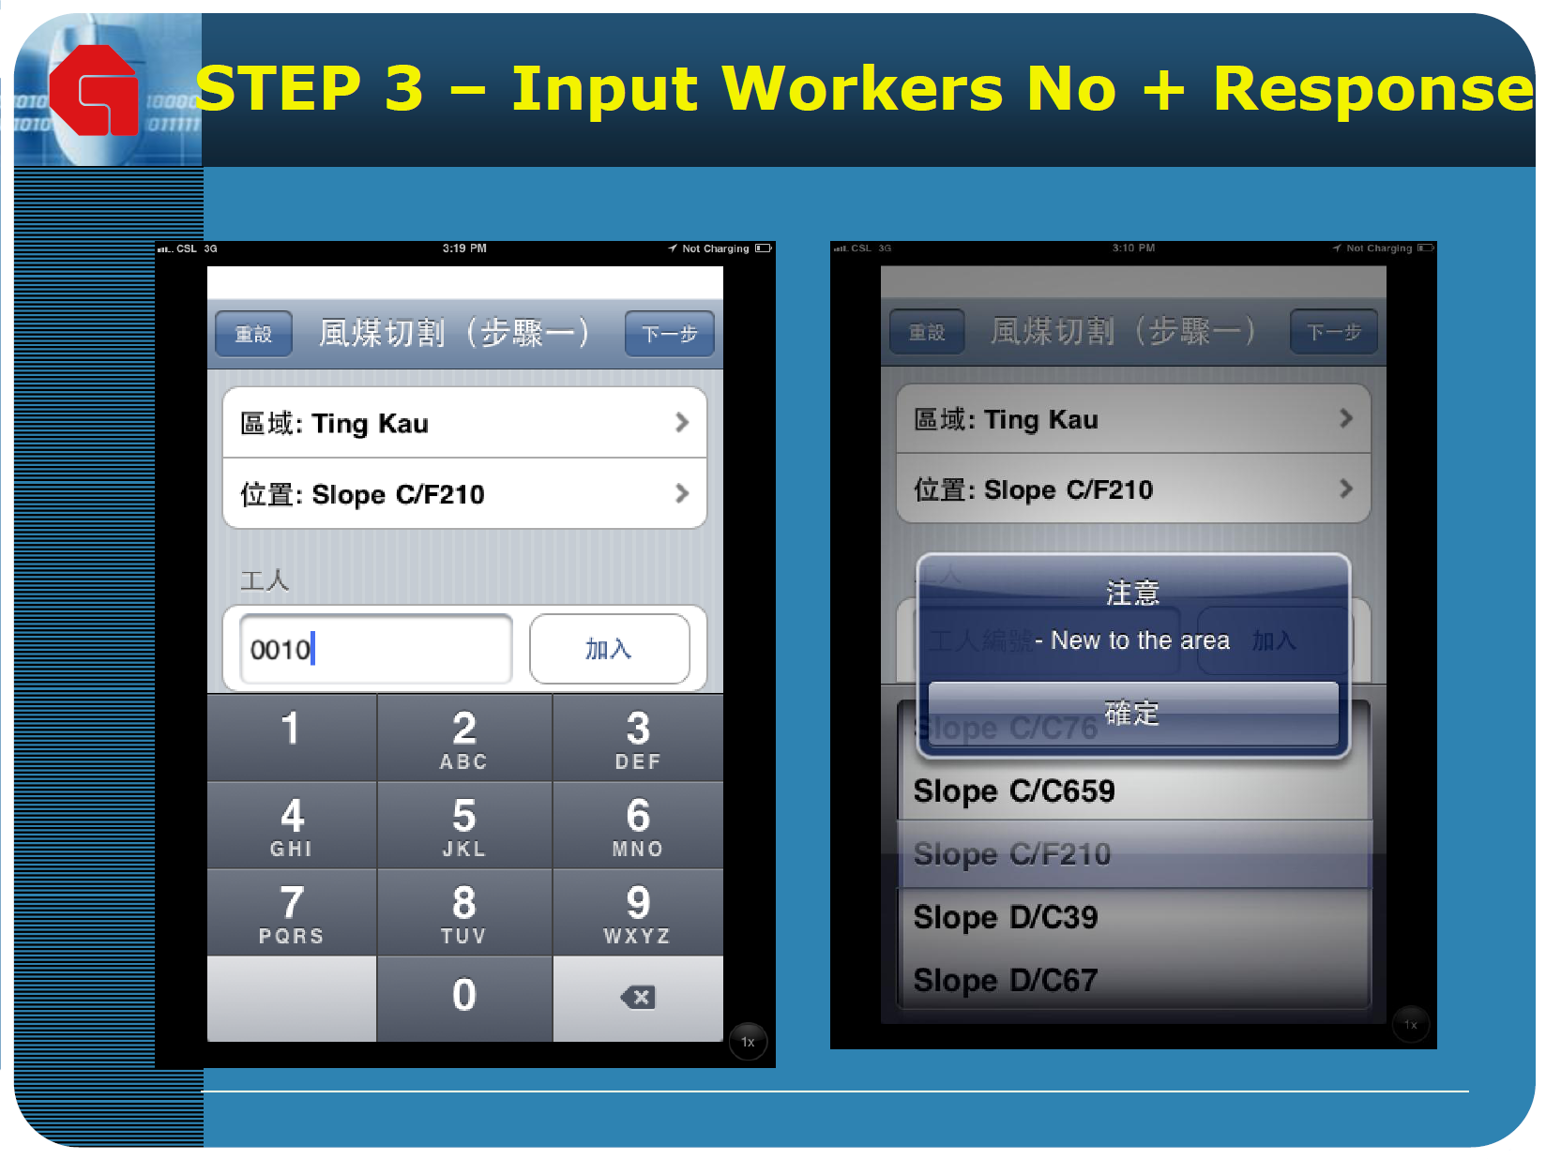

Slide 7
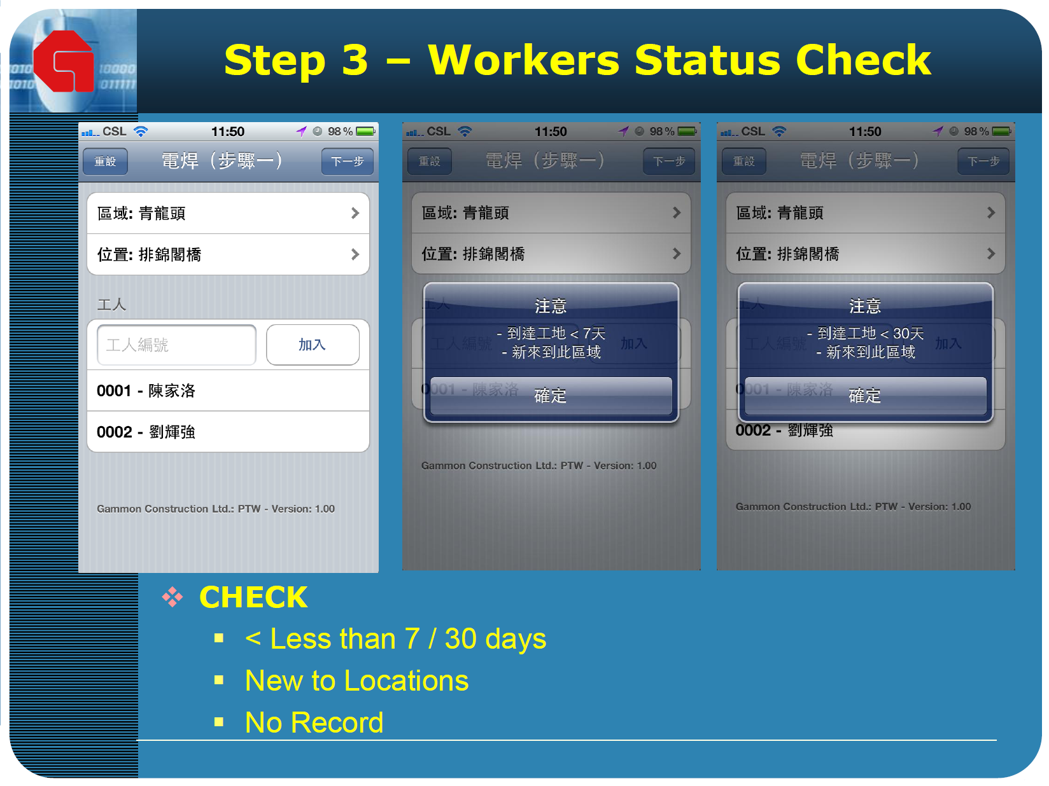

Slide 8
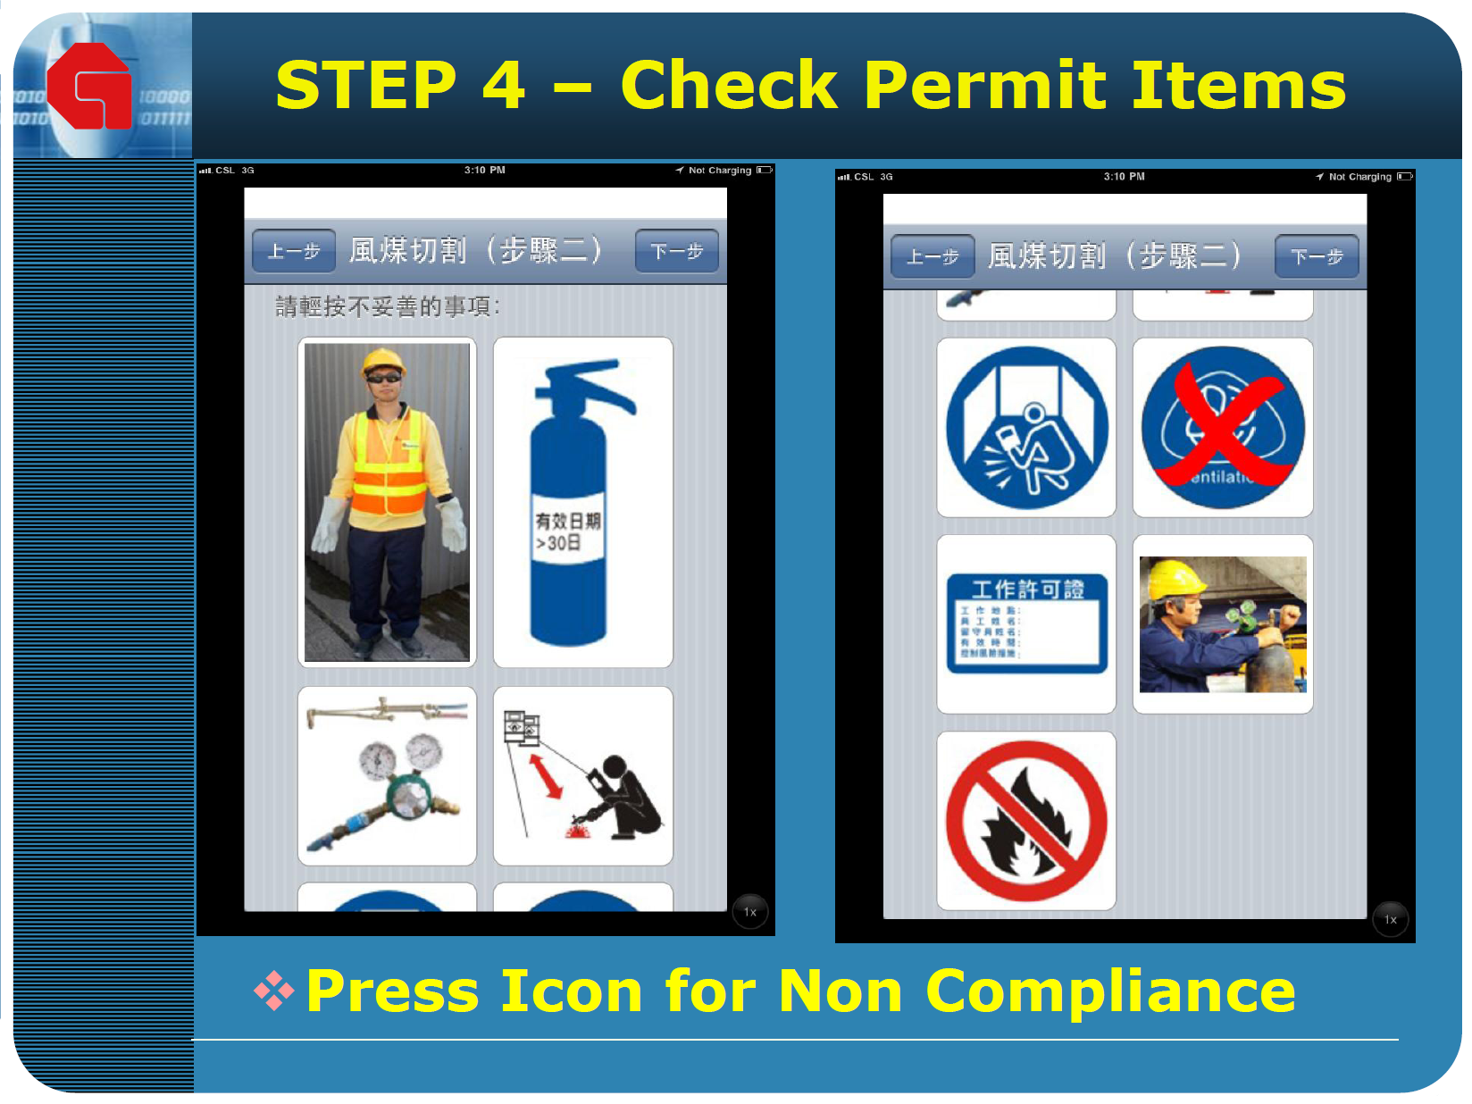

Slide 9
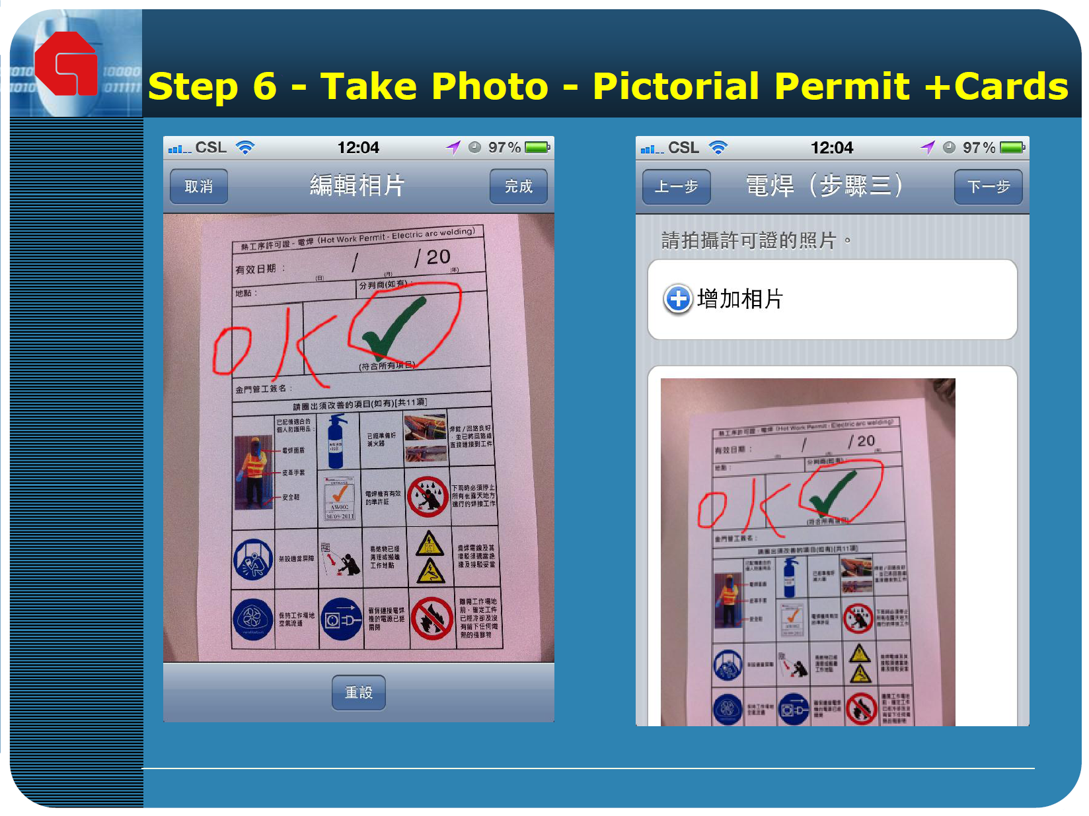
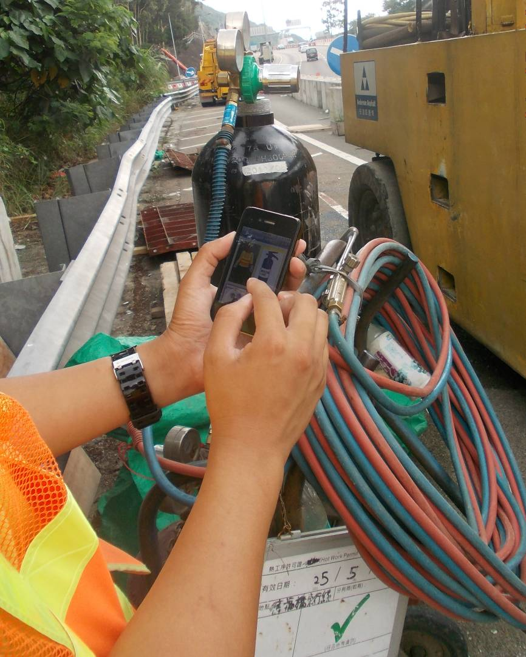
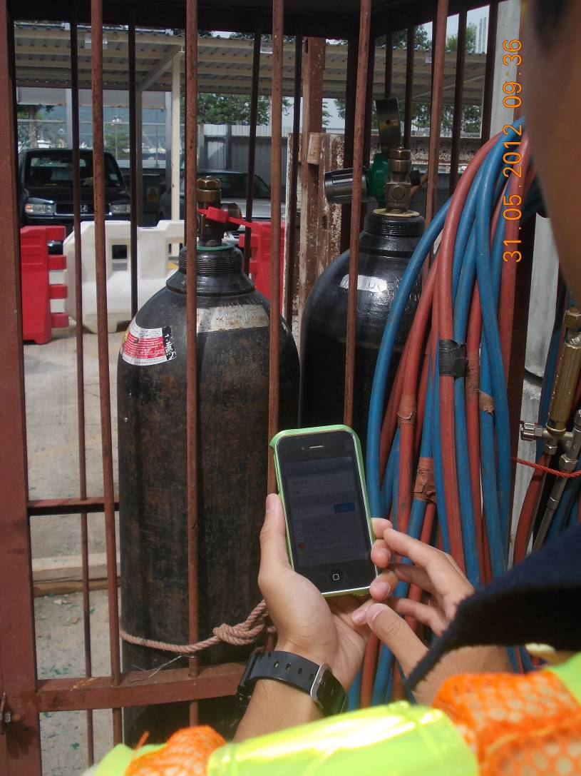
STEP 5 – Take Photos

Slide 10
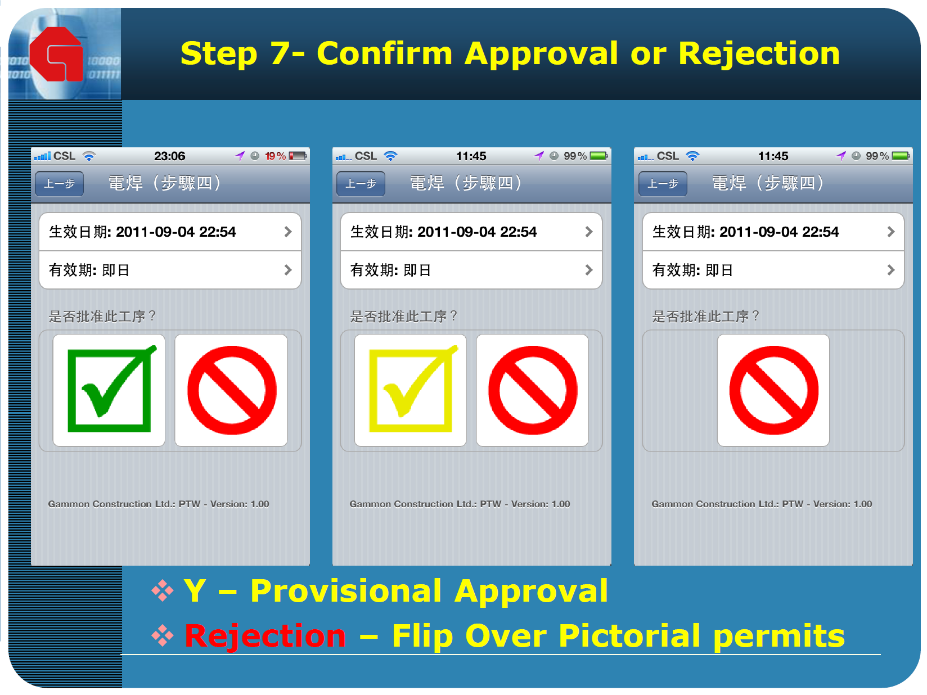
STEP 6 – Confirm Approval or Rejection

Slide 11
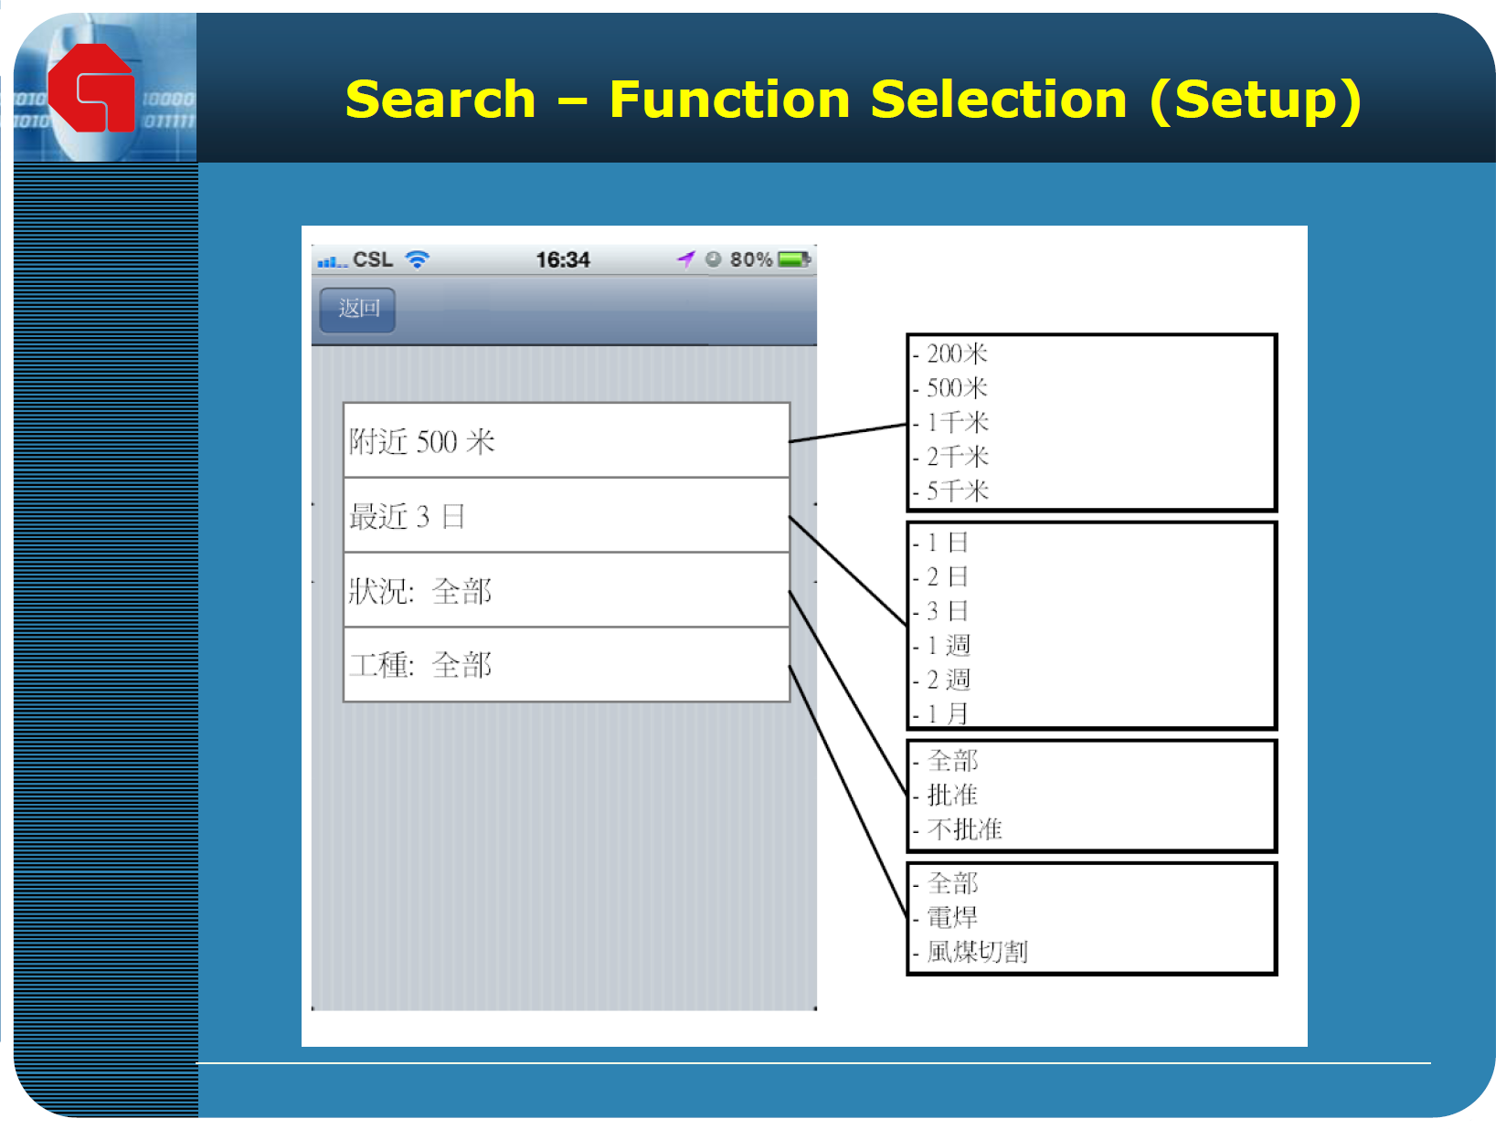
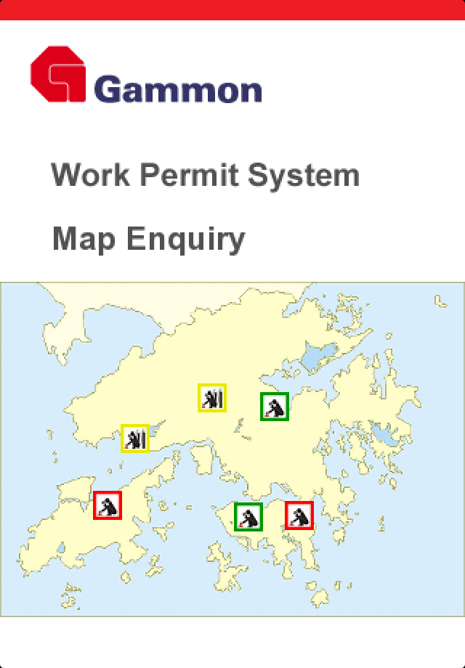
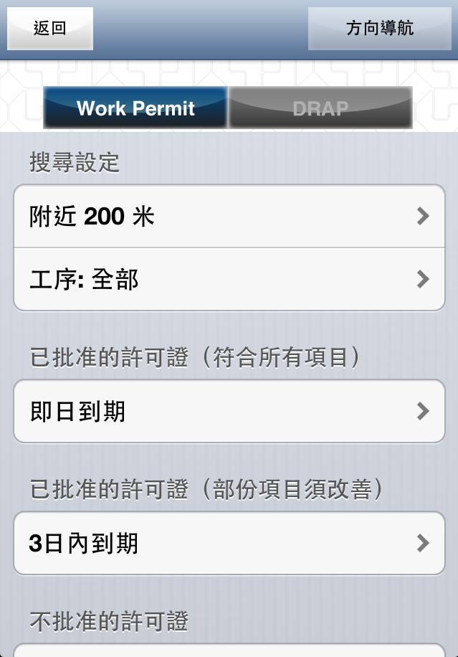

Slide 12
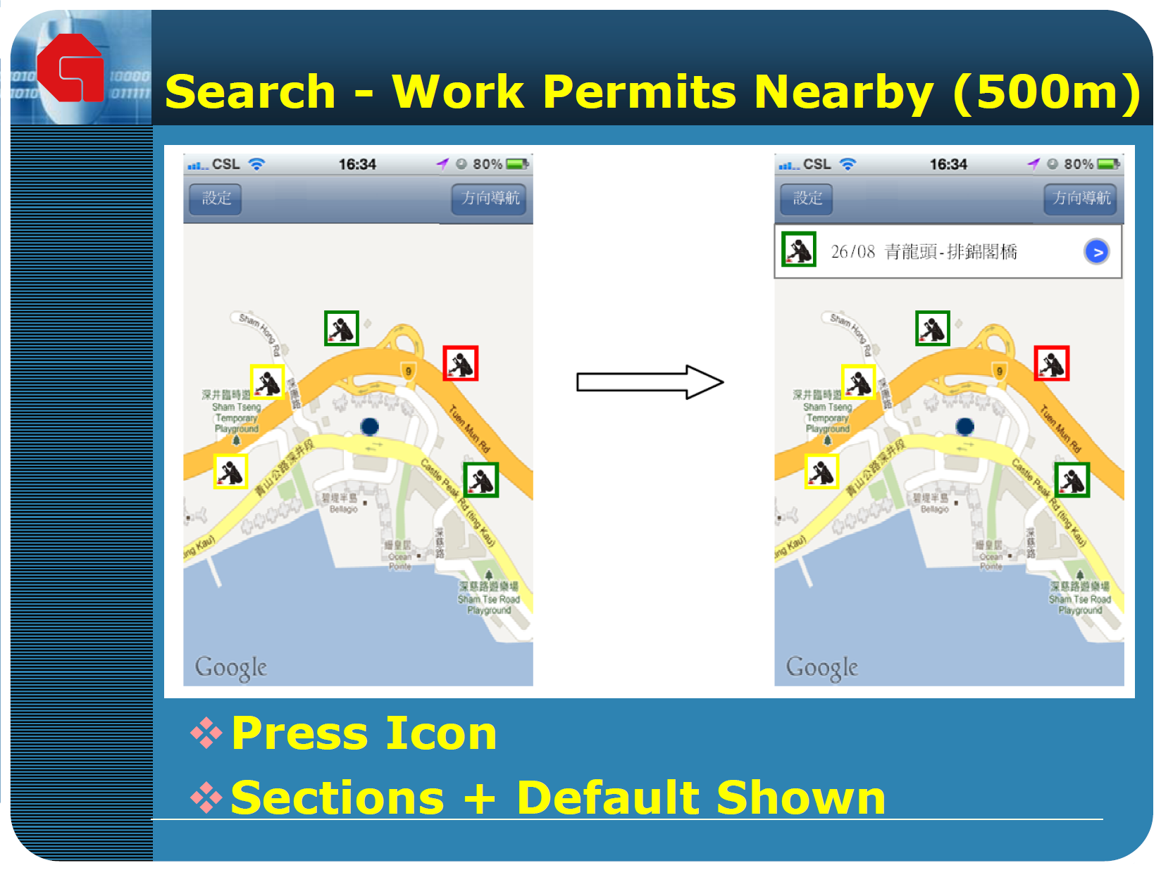

Slide 13


