Slide 1
Innovative Safety Initiative Award 2015
Mechanical Aid Floor Painting at Function Halls, Asia World Expo

Slide 2
Content
Introduction of the Project and Task
Analysis of Problem
Innovative Solution and Effectiveness

Slide 3
Asia World Expo
70,000 square meters of rentable space (exhibitions, conventions, concerts, sports and entertainment events)
10 ground-level, column-free function halls

Slide 4
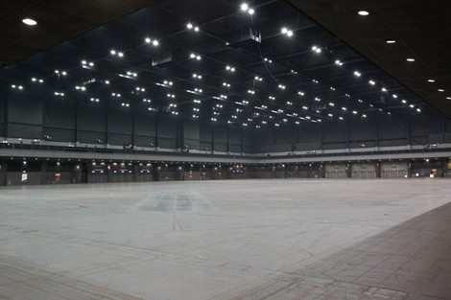
Facility Maintenance
5,680 sq m
Paint 1-2 function halls per month

Slide 5
Problem
Exposure to chemicals from paint and solvent
Prolonged working in an awkward posture resulting in back aches and pains
Inefficiency

Slide 6
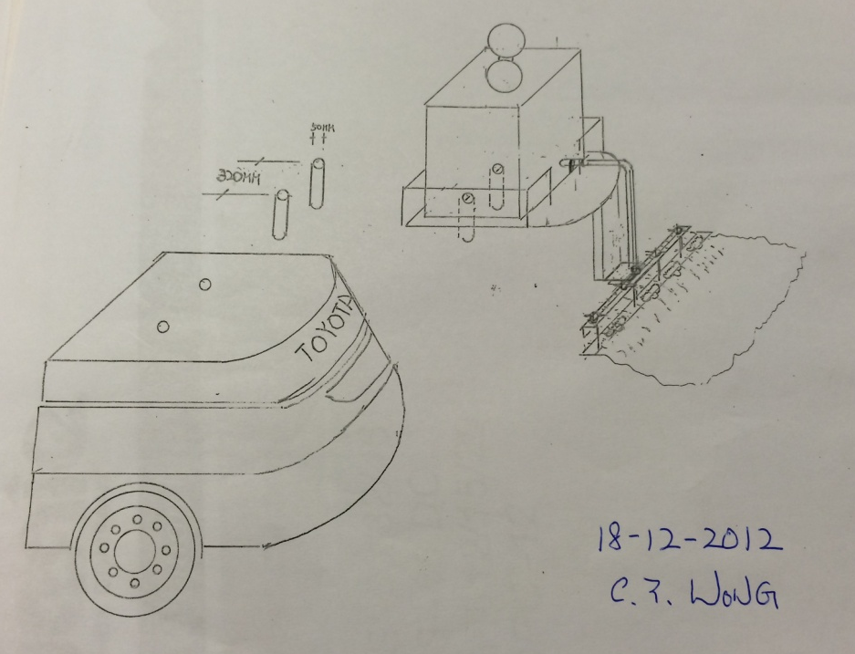
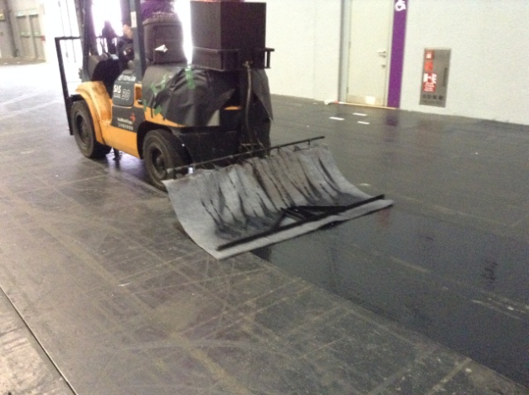
Innovative solution by BYME
Improvising a forklift truck with an aim to reduce manual labour

Slide 7
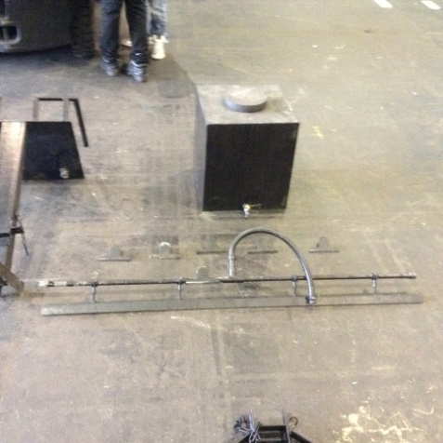
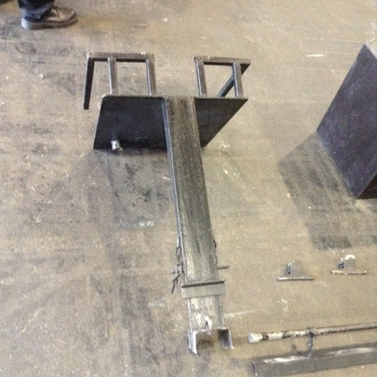
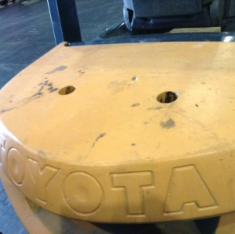
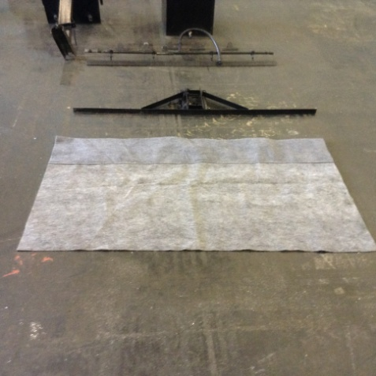
2. The Paint Box and Iron Pipe
1. Paint Box Holder
3. Supporting base
4. Painting Sheet and attachment
1m
1.5m

Slide 8
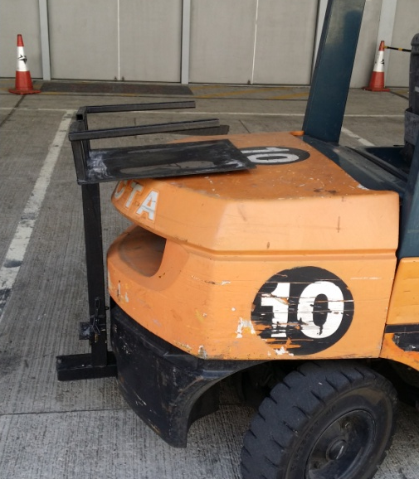
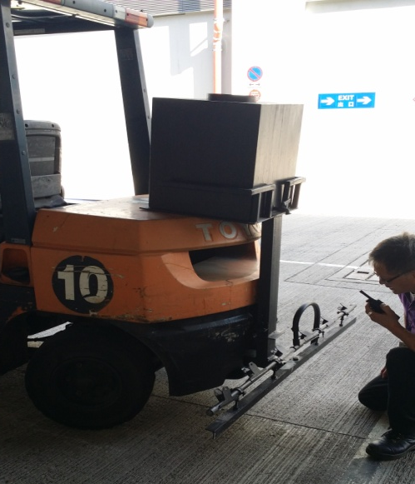
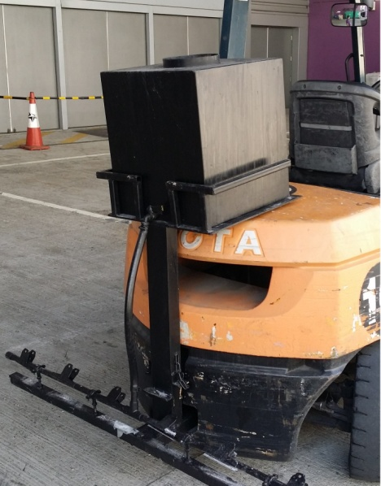
Steps
1
3
2
4
Install the paint box holder in the forklift truck
Install the iron pipe and fix with screw
Put the paint box on the holder and pour the paint inside
Connect hose between the iron pipe and paint box

Slide 9
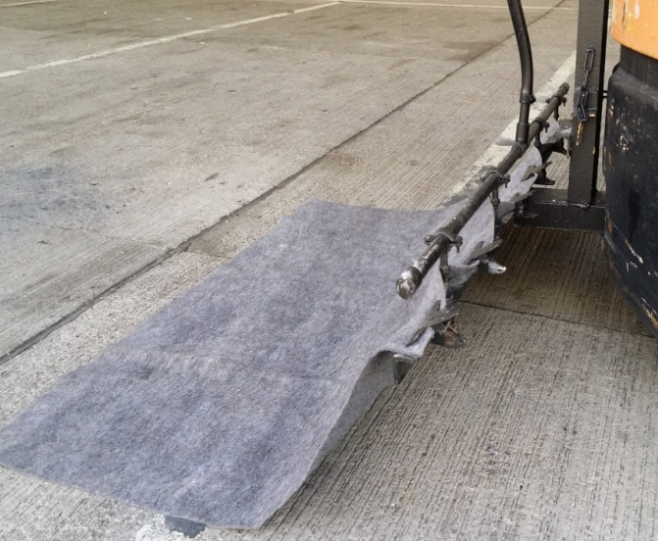
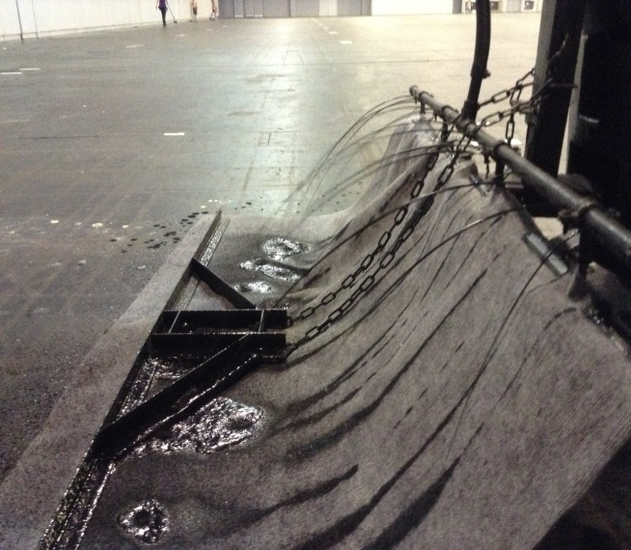
Steps
5
7
6
Use clips to fix between the pipe and painting sheet
Start painting!
Paint run out from the small poles on the iron pipe

Slide 10
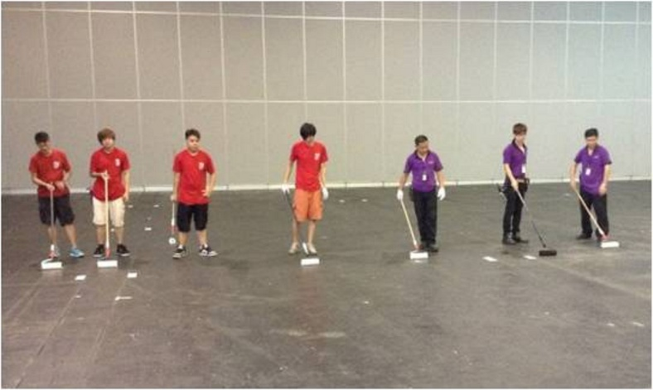
Innovation and Effectiveness
Back aches and paints
Elimination of back health issues
Before
After

Slide 11
Innovation and Effectiveness
Exposure to paint chemicals
Reduction in diffusion of paint
Before
After

Slide 12
Innovation and Effectiveness
3 Workers
3 hours
10 Workers
8 hours

Slide 13
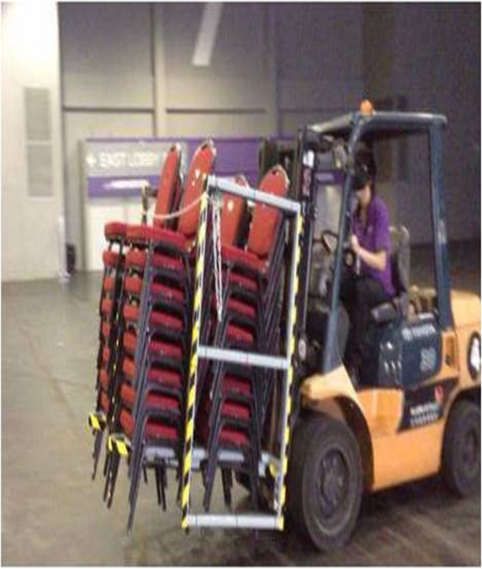
Innovation and Effectiveness
Multi-purpose
Transporting furniture
Painting
Cleaning

Slide 14
The end

