Slide 1

Innovative Safety Initiative Award 2014
Contract No. : DC/2009/23
Harbour Area Treatment Scheme 2A
Harbour Area Treatment Scheme Stage 2A - Upgrading of Preliminary Treatment Works at North Point, Wan Chai East and Central
Leader – JEC Joint Venture

Slide 2

Innovative Safety Initiative Award 2014
Category: Operative Device
Enhancement of emergency rescue system for confined space work
ISIA Reference No:
C3-039
Presented by C K Suen
Manager (S&E)

Slide 3
Method Statement for Installation of Steel Cage and Wall Opening for Sewage Pump Replacement at Flow Distribution Chamber in Wan Chai East PTW
Work Procedure
1, Saw cutting of slab opening with the size of 2.4m x 2.8m
2, Removed the existing 90 degree bend of DN800
3, Installation of steel cage
4, Formwork and concrete surround to the new DN800
5, Remove the steel cage
6, Install the new 90 degree bend of DN800
Initial difficulties that could be forecast
Confined space work: All difficulties already tackled through discussion except the anchor of the lifeline system
How to tackle the anchor of lifeline system?
Use of Electric Overhead Travelling Crane (EOT)
Notes:
3

Slide 4
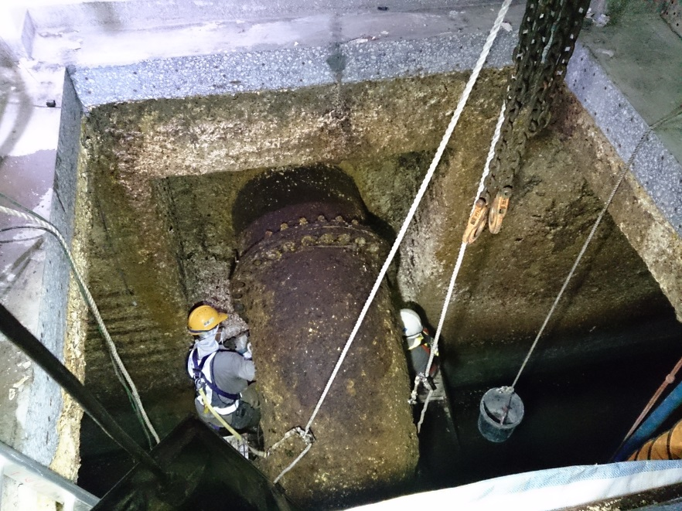
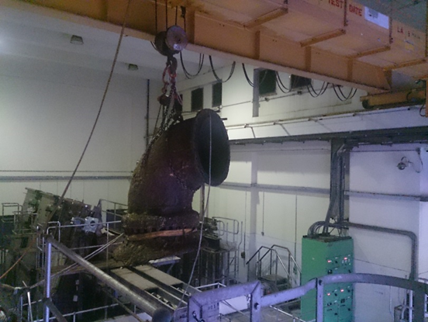
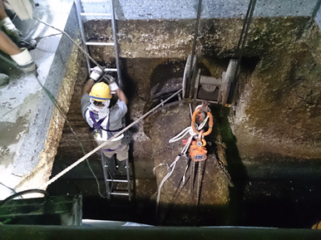
Use of EOT performing an anchor for the lifeline system for people adopting the fall arresting device as well as a rescue system for confined space work.
EOT engaged as the anchor for the lifeline
Worker attached their safety harness to the Independent lifeline
It seems to be effective by engaging the EOT as the lifeline anchorage and rescue provision
However the system not effective at the material time the EOT was being engaged to carry out lifting operation
All people shall have to detach the fall arrestor from the lifeline as the EOT was being engaged.
Notes:
4

Slide 5


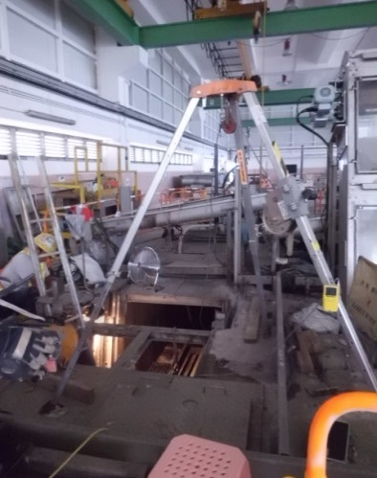
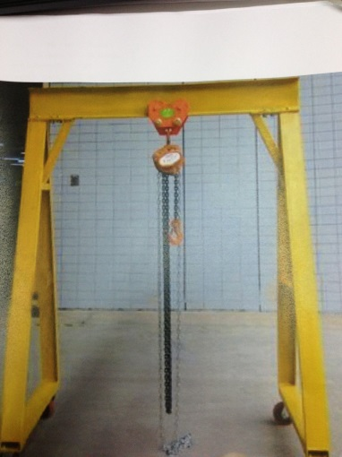

TWO major issues raised
Issue no 1, How can we provide and maintain the independent and effective emergency rescue system at the time the people could still stay at the confined space AND the EOT was in operation without obstruction? As the forthcoming activity was to install the steel cage. It would be lifted by the EOT and at the same time workers need to fixing screw around the cage.
Issue no 2, How to protect the workers continuously AND independently by the fall arresting as well as rescue system at the time leaving and staying into the confined space?
Consider to use the tripod system
Consider to use tailor made A-shape frame as an independent rescue as well as fall arresting system
Consider to just secure a lifeline to adjacent structure, and pull out by manual if accident occurred
Could the approach achieve the objective as above-mentioned to tackle the two major issues?
Obstruction of EOT operation
Tripod/A-Shape frame and EOT can not be operated simultaneously
Issue no 1: Not Achieved as not effective and reliable
Issue no 2: Achieved but not effective and reliable
Issue no 1: Not Achieved
Issue no 2: Not Achieved
The span of the opening was too long where the Tripod can not be installed
Issue no 1: Not Achieved
Issue no 2: Achieved
Notes:
5

Slide 6

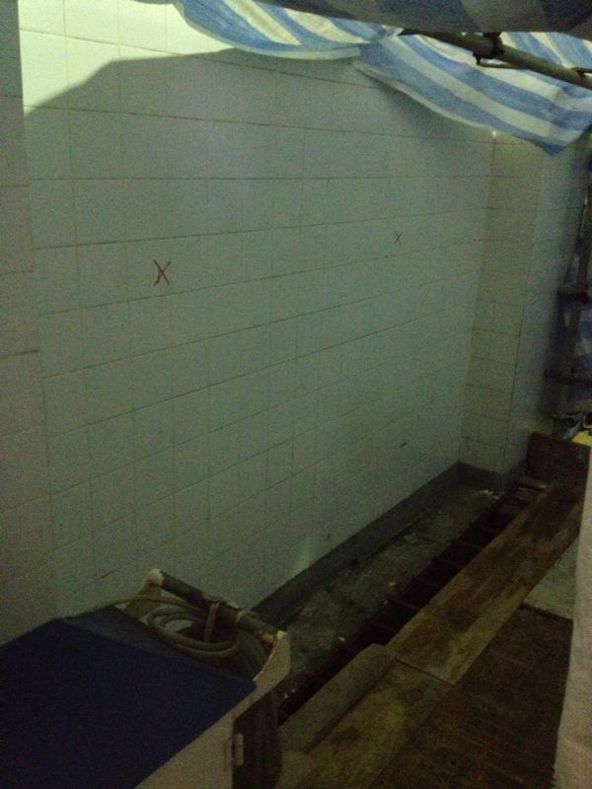


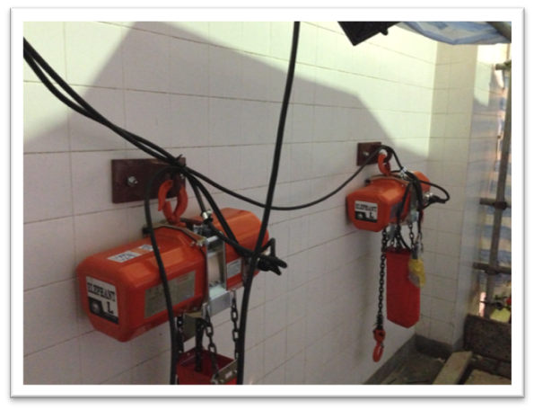
Wall Mounted Electric Chain Hoists
System independent? Yes (No interference from the EOT operation)
Marking of the location for the electric chain hoist
System effective? Yes (Certified the SWL of 1.0 T)
System reliable? Yes (supplied by permanent electrical power thus no risk of electrical short circuit, and better than pulling out the person for emergency by manual)
Easy to control? Yes (Not required operating license, only two bottons)
Not to generate obstruction to EOT operation? Yes (Mounted on wall and just behind the opening)
System can serve for multi-purposes? Yes (Could be performed as fall arresting device, emergency evacuation device and LA for lifting operation)
Notes:
6

Slide 7


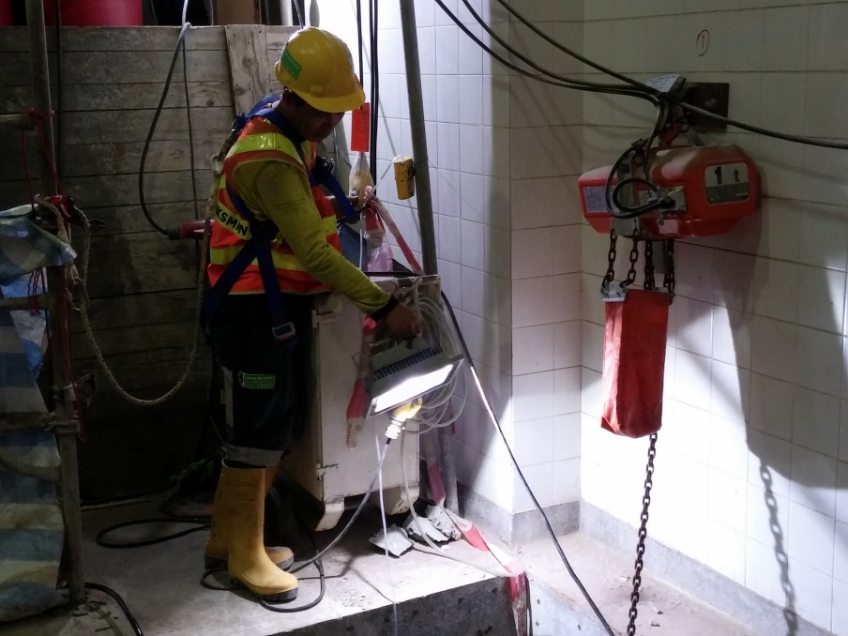
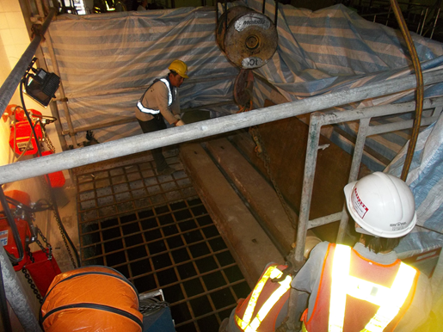
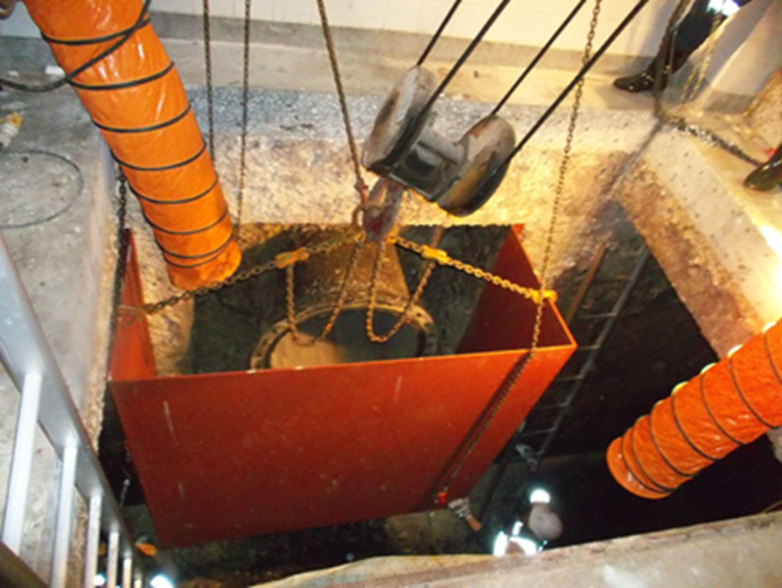
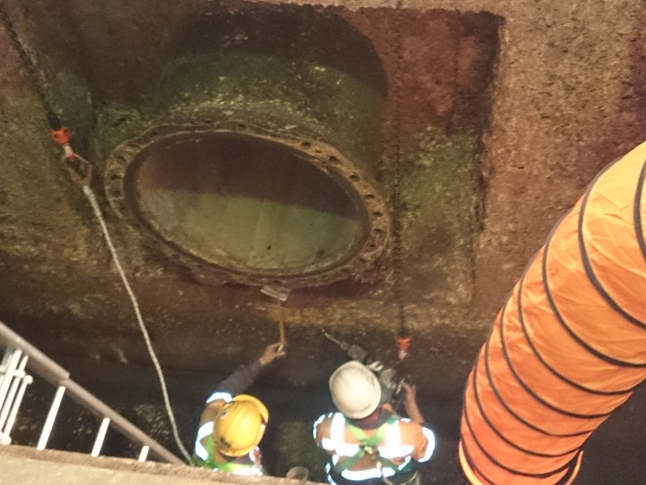
The new rescue system was in full operation
Removal and reinstatement of the cover of the opening by means of EOT
Easy to control, just ‘up’ and ‘down’ buttons
And no need to have operating license
New emergency rescue system: Wall mounted electrical chain hoist
EOT being used to carry out lifting operation as usual and without generating interference to the new emergency rescue system
Workers carried out drilling work under the protection of new emergency rescue system
Worker still under protection by the new emergency rescue system

