Slide 1

Innovative Safety Initiative Award 2013
Jointly Organized by DEVB, CIC and HKCA
CHUN WO-CRGL-MBEC JOINT VENTURE
Contract No. HY/2009/19
Central- Wan Chai Bypass – Tunnel (North Point Section) and Island Eastern Corridor Link

Slide 2
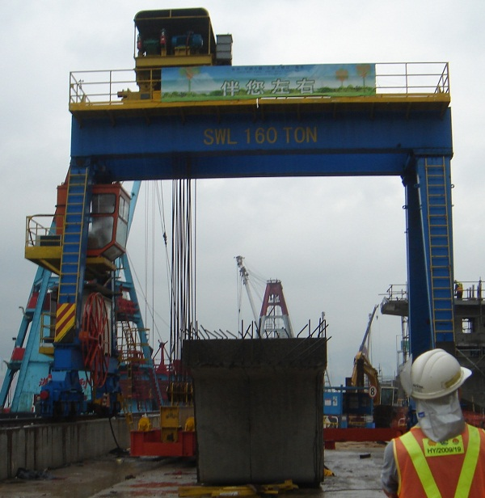
Gantry Crane Ultrasonic Warning System for Mobilization
Gantry crane is selected for lifting and transporting of pre-cast bridge segment at storage yard, due to heavy lifting and transportation efficiency.
There are two blind points while segment is lifting and the gantry operator is not able to notify.

Slide 3
SWL 160 TON
Bang!

Slide 4
Gantry Crane Ultrasonic Warning System for Mobilization
In order to eliminate the hazard, the pro-active warning system for gantry crane mobilizing on rail is installed by using the ultrasonic sensor to detect obstacle / pass-by worker on rail. The progressive visual is generated by flash light and audio warning sign is triggered by buzzer to crane operator.
The system also eliminates the blind point while segment is lifting, where the visual paths of gantry crane are blocked by segment. It is greatly appreciated by gantry operator.

Slide 5
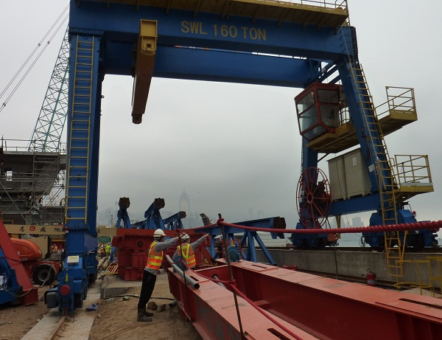
Gantry Crane Ultrasonic Warning System for Mobilization
General view of gantry crane

Slide 6
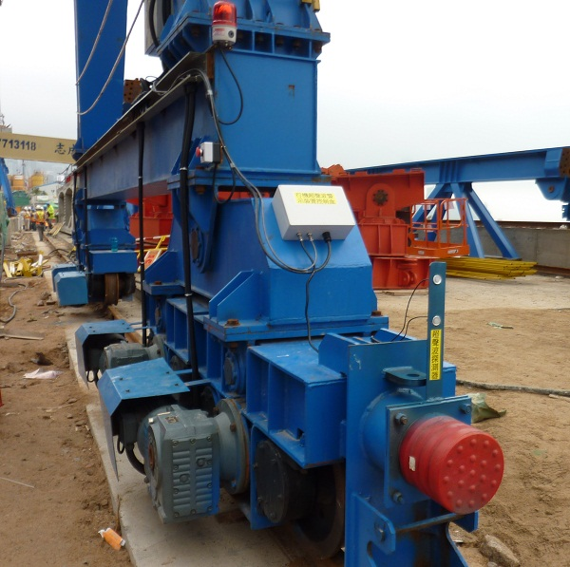
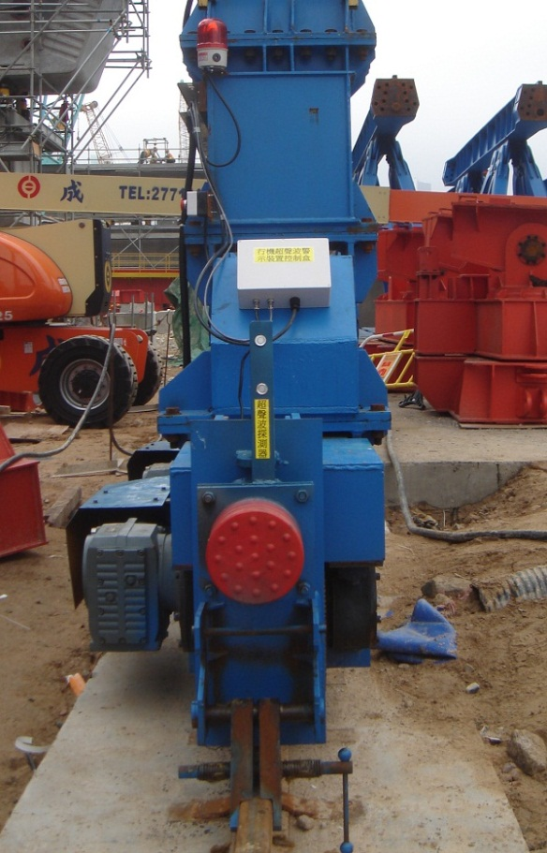
Gantry Crane Ultrasonic Warning System for Mobilization
Ultrasonic sensor
Control box
Ultrasonic sensor

Slide 7
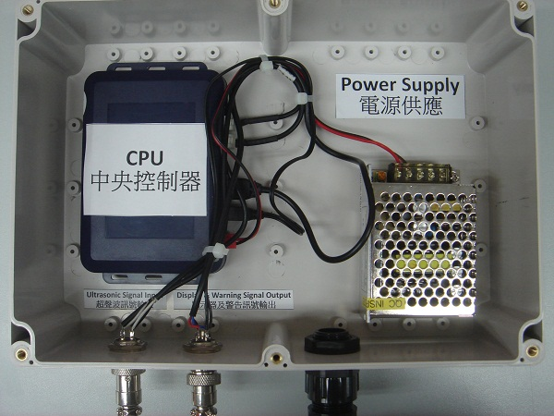
Gantry Crane Ultrasonic Warning System for Mobilization
Control box
Ultrasonic sensor
Configuration and wire connection of control box
Device set up on crane

Slide 8
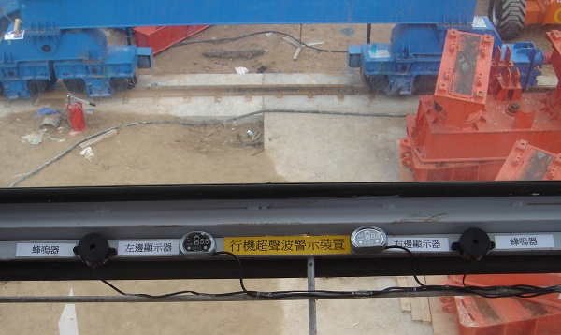
Gantry Crane Ultrasonic Warning System for Mobilization
Visual display
Buzzer
Visual warning display & audio warning device installed at operating cabin

Slide 9
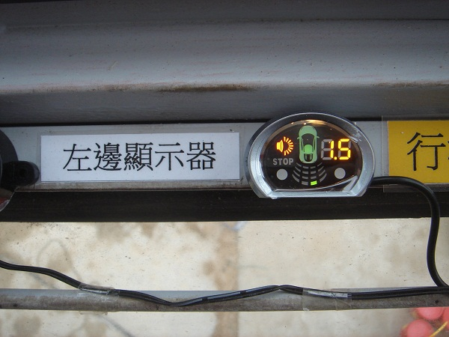
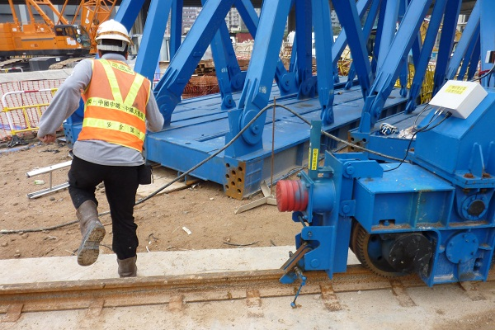
Gantry Crane Ultrasonic Warning System for Mobilization
Left side warning device detects worker walks near the leg of crane. Pre-warning visual and audio signal is given.
Worker walks near the leg of crane

Slide 10
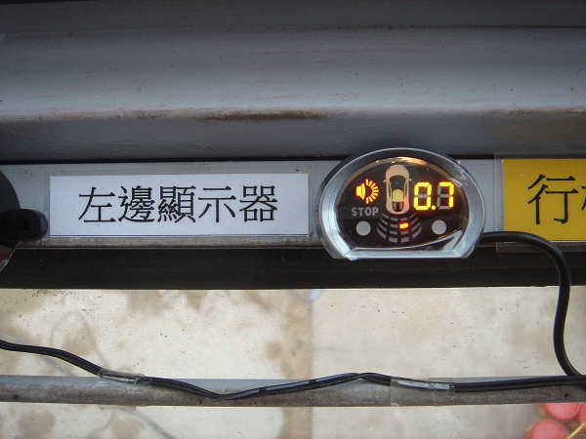
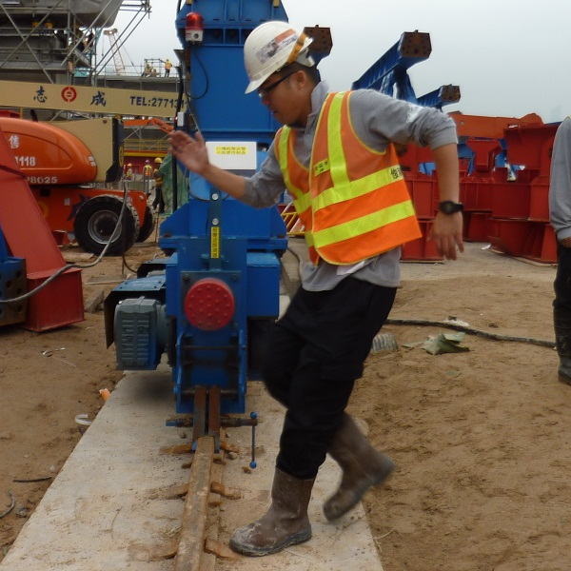
Gantry Crane Ultrasonic Warning System for Mobilization
Left side warning device detects worker walks closed to leg of crane, visual and audio warning signal is given.
Worker works close to the leg of crane

Slide 11
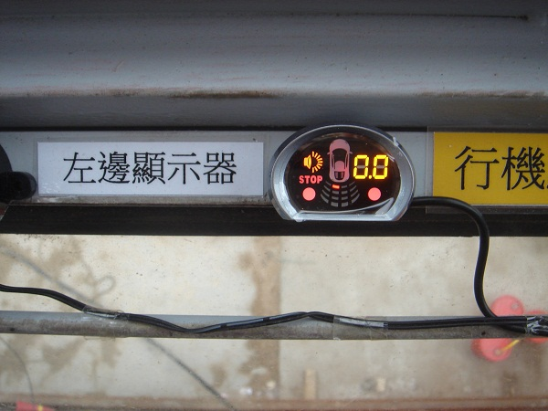
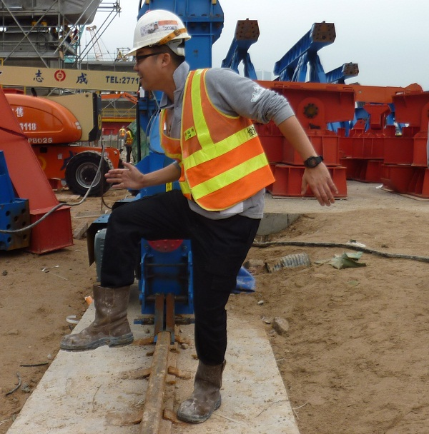
Gantry Crane Ultrasonic Warning System for Mobilization
Left side warning device detects worker walks very closed to the leg of crane, stop operation in visual and audio warning is given.
Worker walks very close to the leg of crane

Slide 12
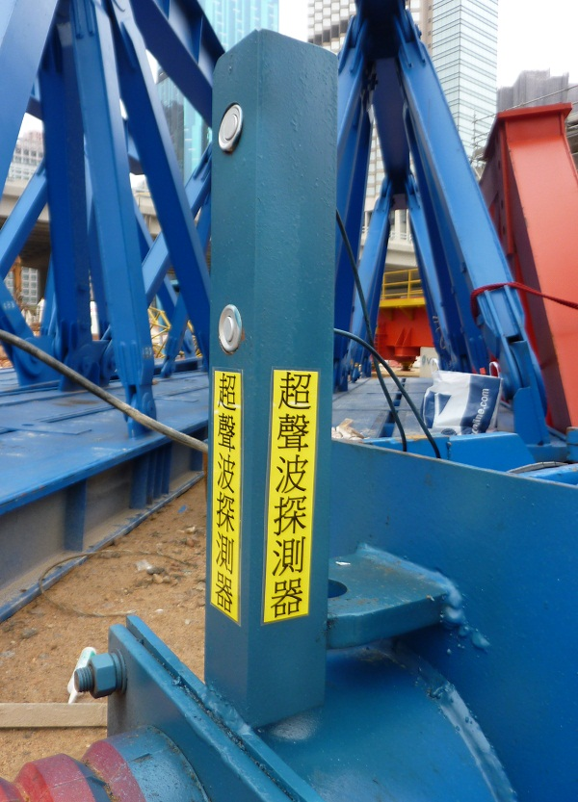
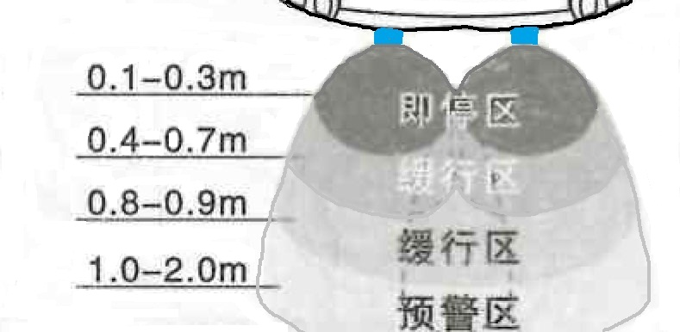
Gantry Crane Ultrasonic Warning System for Mobilization
Ultrasonic sensor
Ultrasonic sensor installed at leg of gantry crane
Warning zone of ultrasonic warning device

Slide 13
SWL 160 TON
1.5M
Bi
1M
Bi-Bi-Bi
0.5M

Slide 14
Gantry Crane Ultrasonic Warning System for Mobilization
Warning zone | Range of warning zone | LED Light (Visual) | Warning sound (Audio) | Action should be taken by crane operator
Pre-warning zone | >1.2m | Point mark only | Bi (one tone) | Alert
Buffer zone | About 1.0 ~ 1.2m | Blue mark | Bi-Bi tone (3/4 sec.) | Alert
Buffer zone | About 0.8 ~ 0.9m | Green mark | Bi-Bi tone (1/2 sec.) | Prepare to slow down
Buffer zone | About 0.4 ~ 0.7m | Yellow mark | Bi-Bi-Bi (1/3 sec.) | Slow down
Stop zone | About 0.1 ~.03m | Red mark | Bi-Bi-Bi (1/5 sec.) | Stop at once
Visual and Audio signal for warning zone and action taken

