Slide 1
Pedestrian Access System for protection of workers working close to high speed road
HY/2012/07 – Tuen Mun Chek Lap Kok Link - Southern Connection

Slide 2
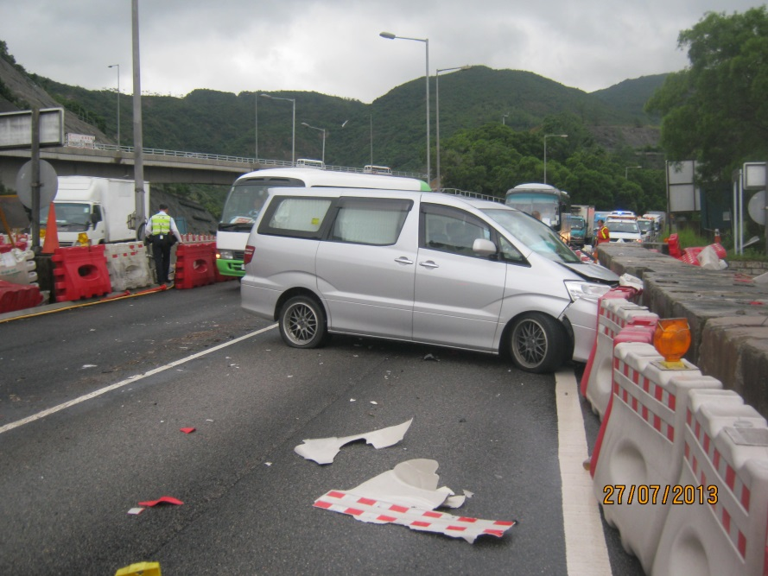
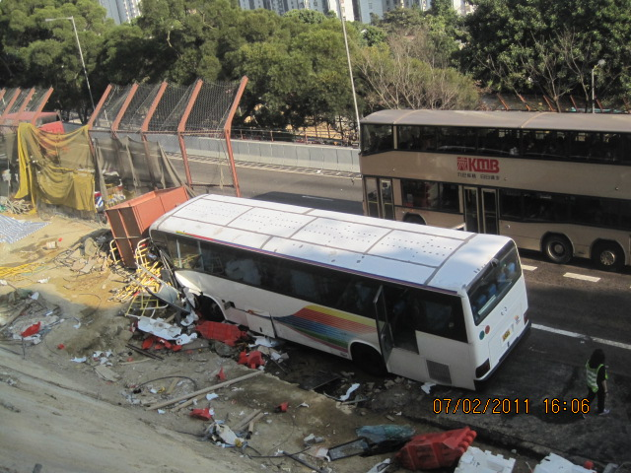
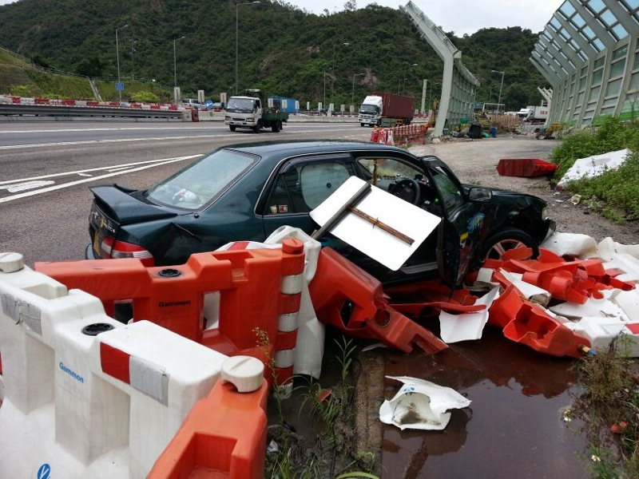
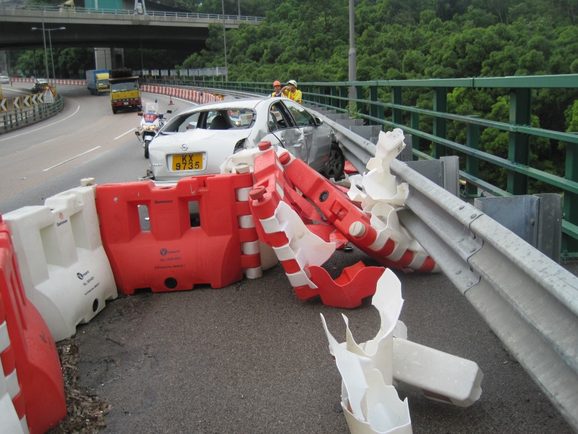
Learnt from past

Slide 3
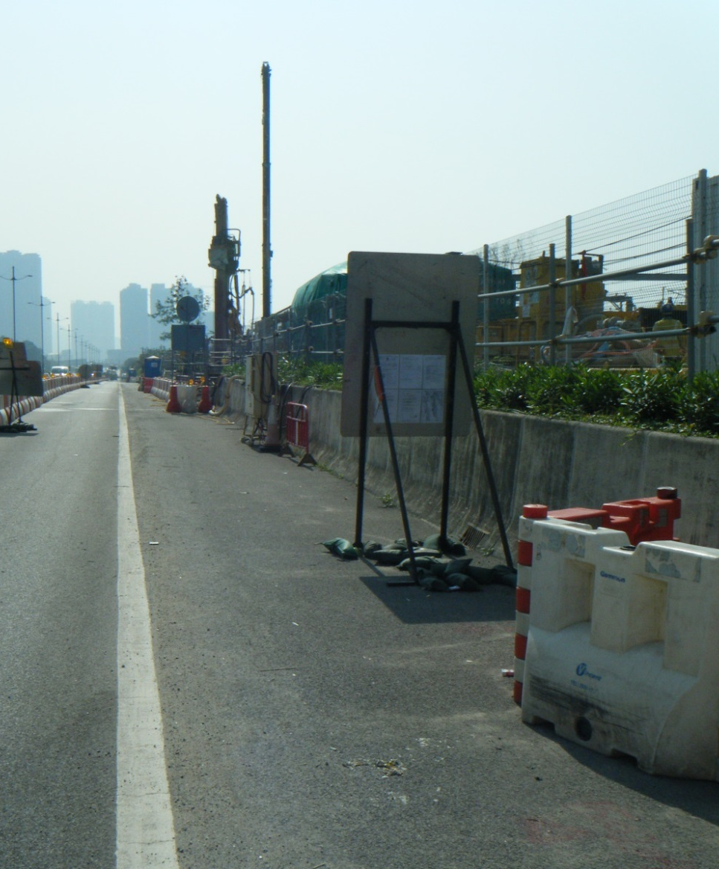
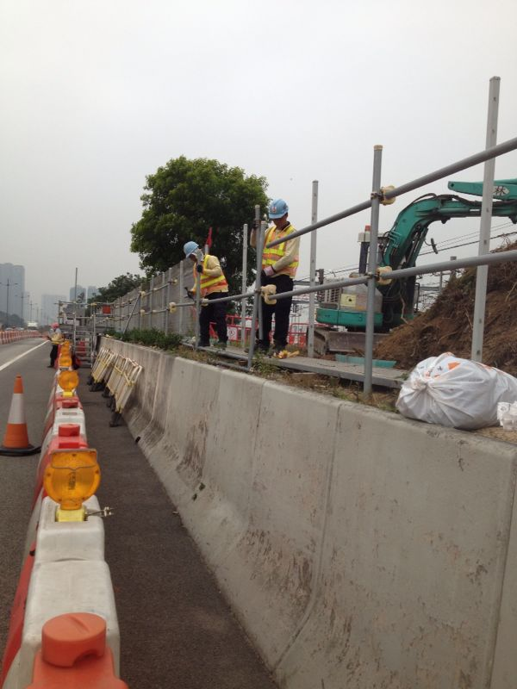
Using Existing Profile Barriers
Existing Profile Barriers

Slide 4
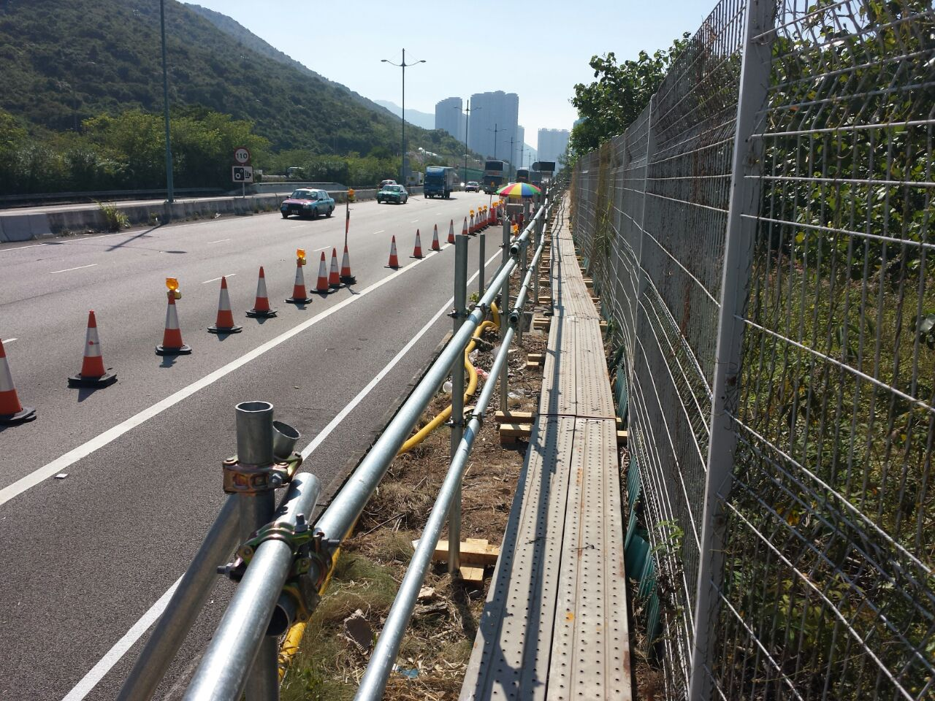
Extra protection for TTA entrance

