Slide 1
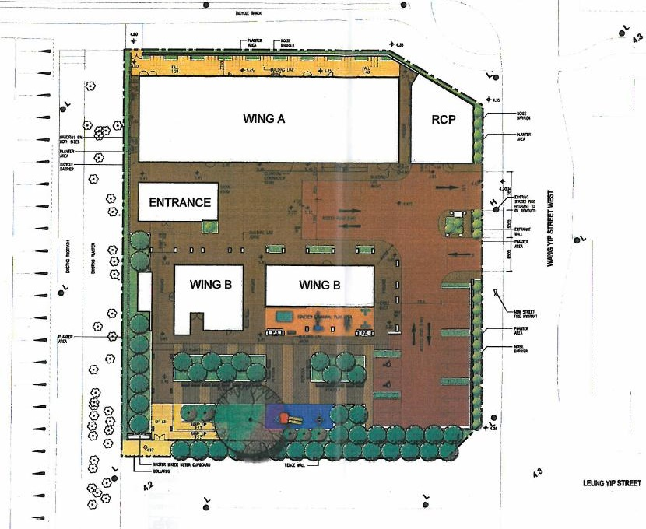
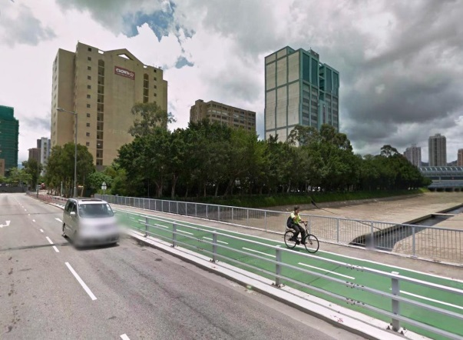
Innovative Safety Initiative Award 2015 Presentation Construction of Home Ownership Scheme at Wang Yip Street West, Yuen Long HKHA Contract No. 20130046

Slide 2
1. Key safety issues
A real time controlling and monitoring system is an important part of the safety management system.
The hazards inhered within the works area :
The number of accesses is limited
The works area is arranged in complex grids of buttress walls.

Slide 3
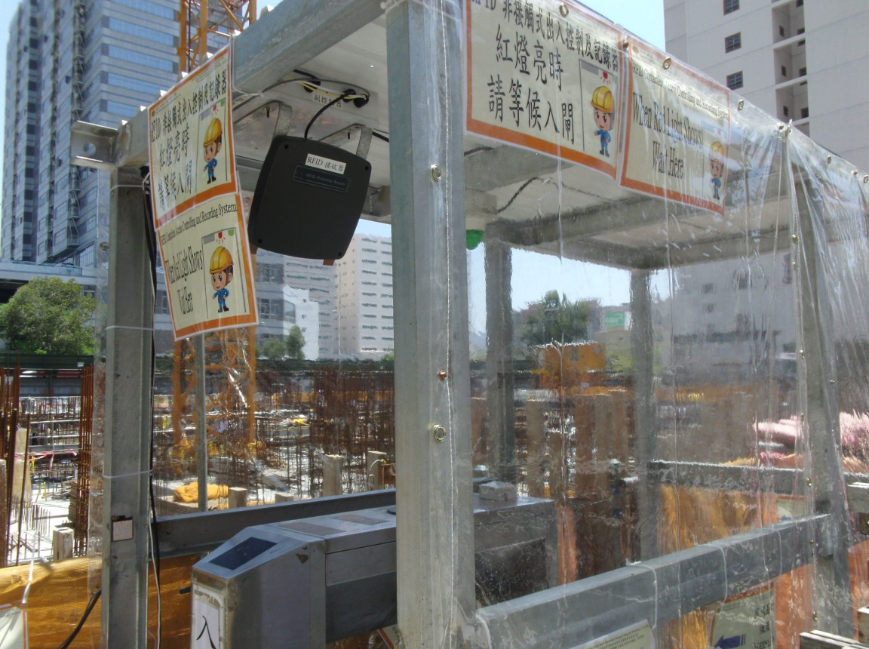
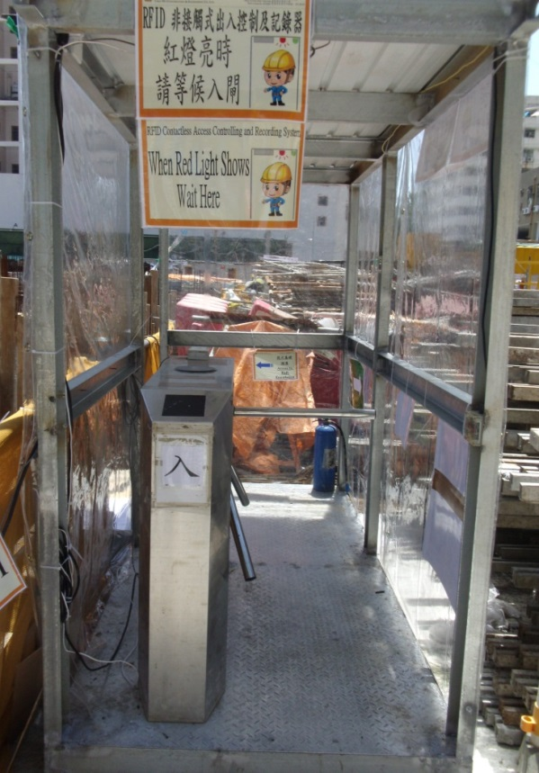
Slave Controller
Long Range RFID Reader
Red & Green
Signal Lights and Chimes
Infra-red Sensor
Turnstile
Photo 1. View of the access entrance
(stairway to works area of ELS/ Raft Foundation)

Slide 4
2. Benefit of RFID Contactless Access Controlling and Recording System
Automatic ID recoding and monitoring process
Automatic controlling of turnstile for authorised worker for future expansion for confined space
Automatic Alert / Warning
Reduce the extra manpower needed
Easy to use for real time record and report
Easy for setting up and is movable
Durable enough for repeated use

Slide 5
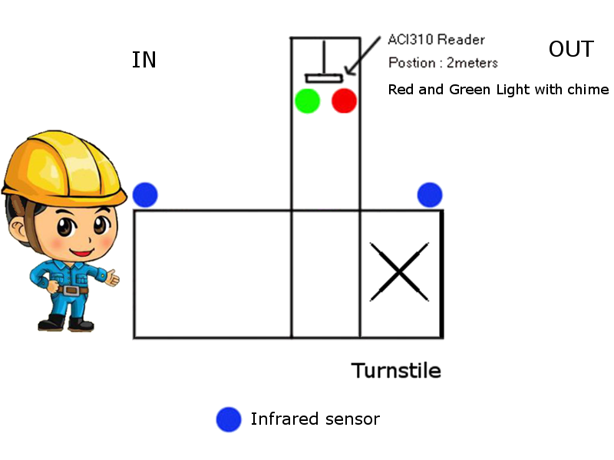
Photo 3. Illustration of functioning of the System

Slide 6
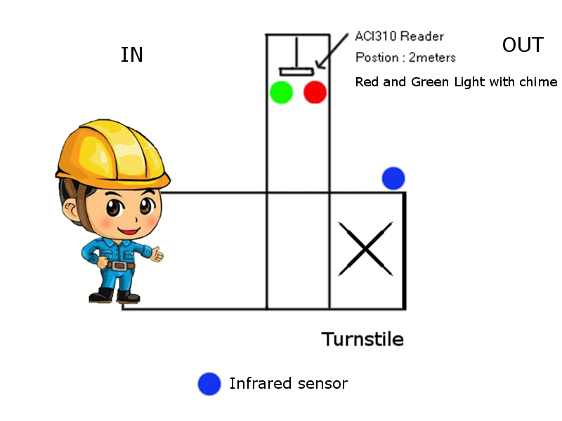
Photo 3. Illustration of functioning of the System

Slide 7
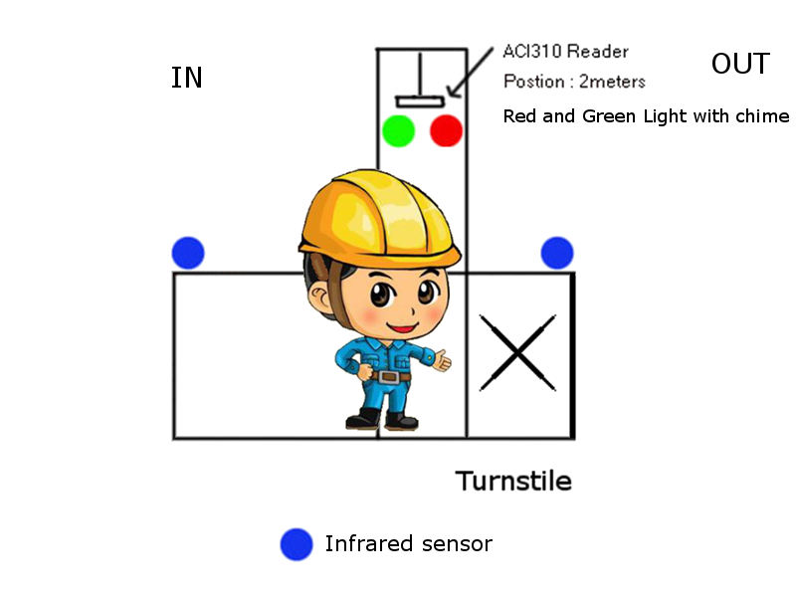
Photo 3. Illustration of functioning of the System

Slide 8
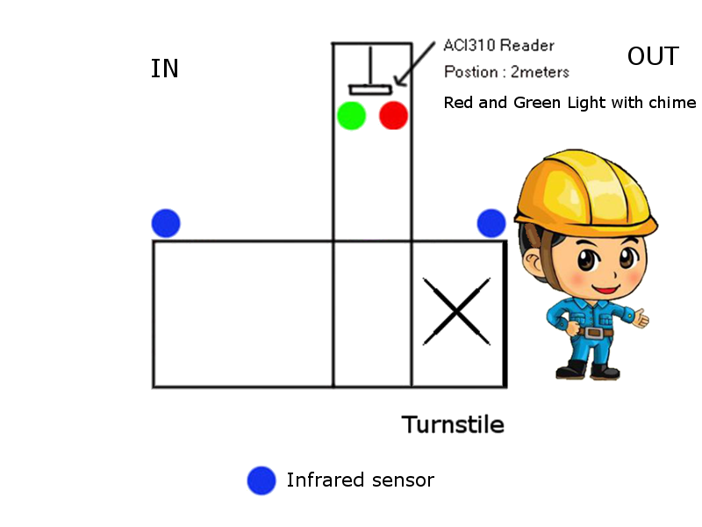
Photo 3. Illustration of functioning of the System

Slide 9
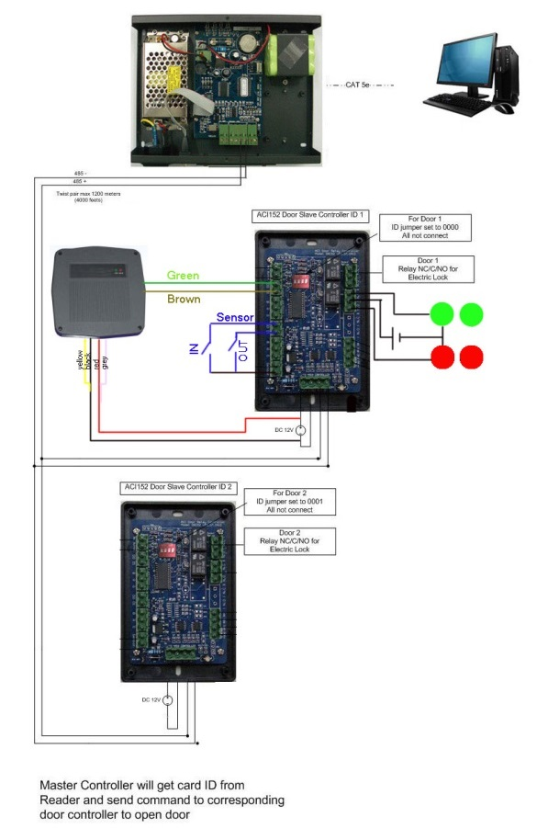
3. Tailor-Made to In-house Design Intent
System consists of :
Master controller
Slave controller with turnstile
Long range RFID reader
Infra-red sensors
RFID tag attached inside safety helmet
A computer and software
Photo 1. Schematic Diagram
of The System

Slide 10
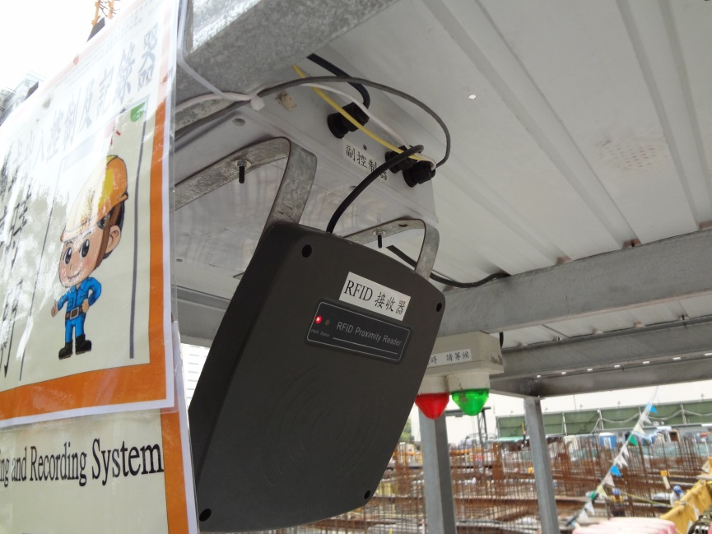
Slave Controller
Long Range RFID Reader
Red & Green
Signal Lights and Chimes
Photo 4. Closer view of the RFID Reader, Slave Controller and Red & Green Lights
Photo 5. RFID Tag inside Safety Helmet

Slide 11
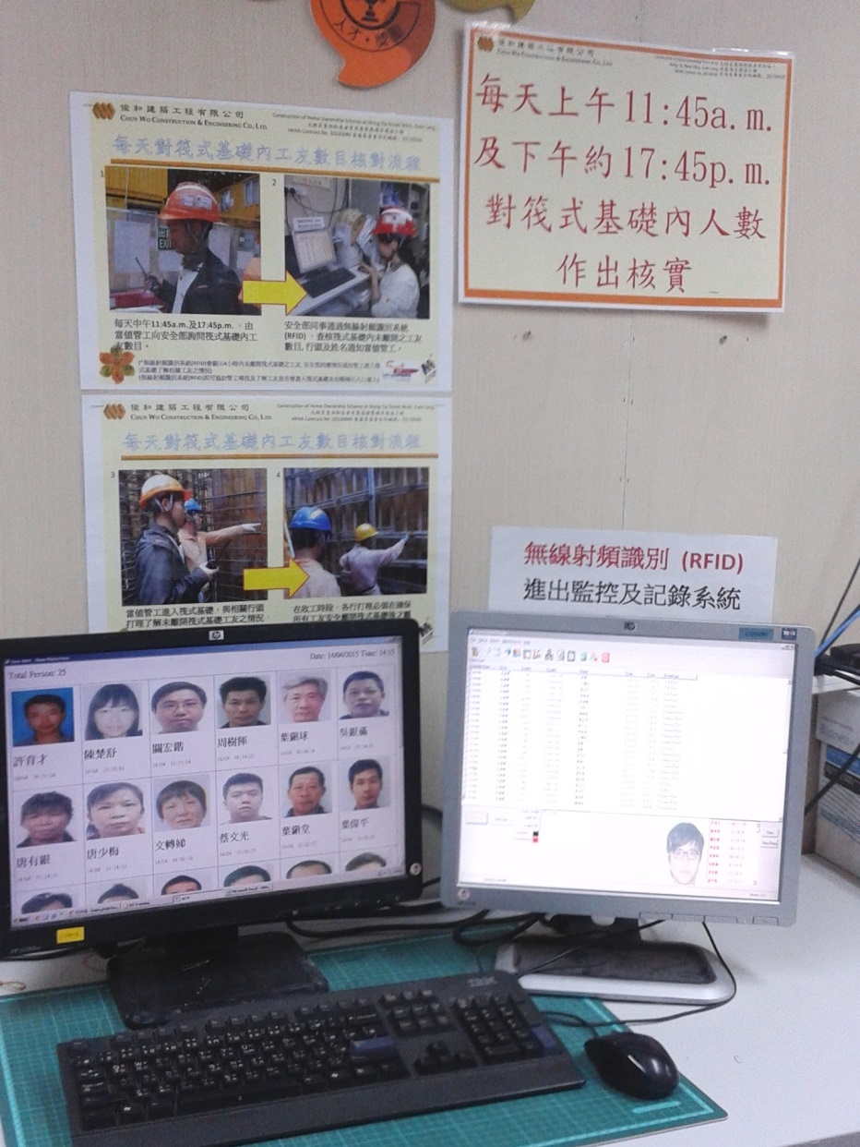
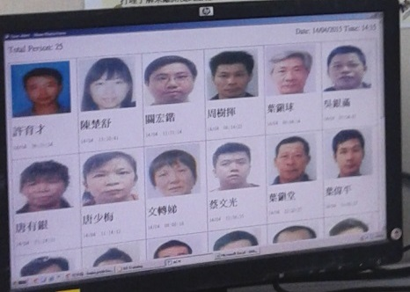
Photo 6. Real time IN & OUT Log and current list of workers inside workplace with photo

Slide 12
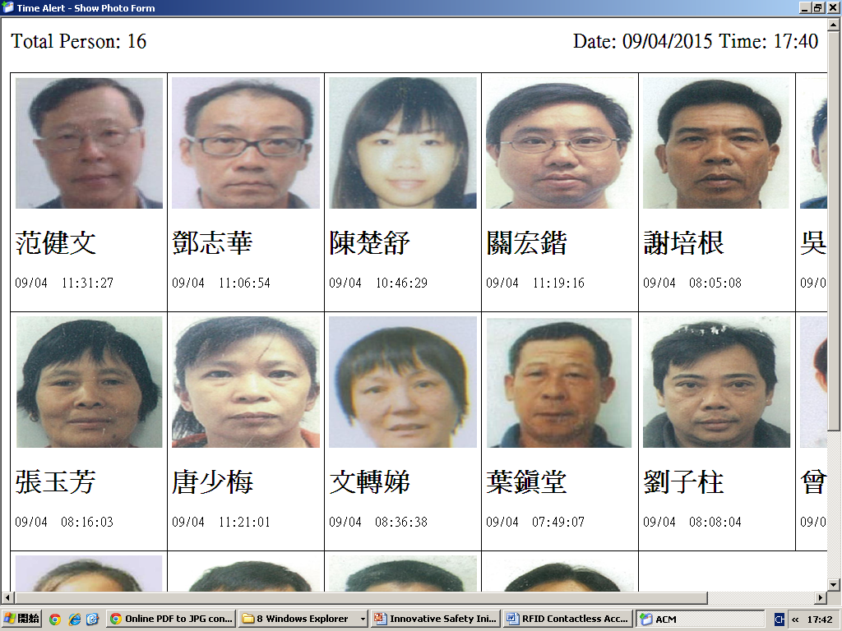
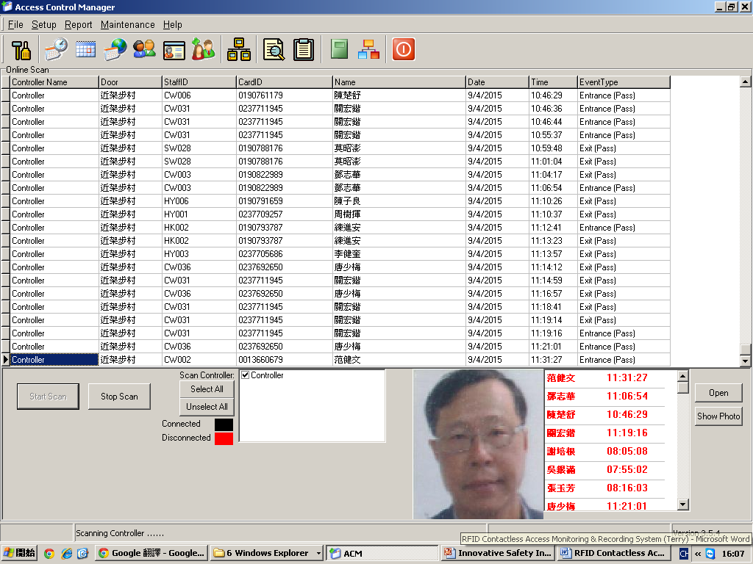
Screenshot 1 .Real time IN & OUT Log and current list of workers inside workplace

Slide 13
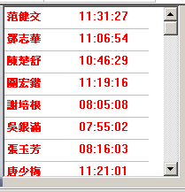
Screenshot 2 .Real Time Alert of workers who had been entered Raft Foundation over specified time
(Current Setting: 4 Hours)

Slide 14
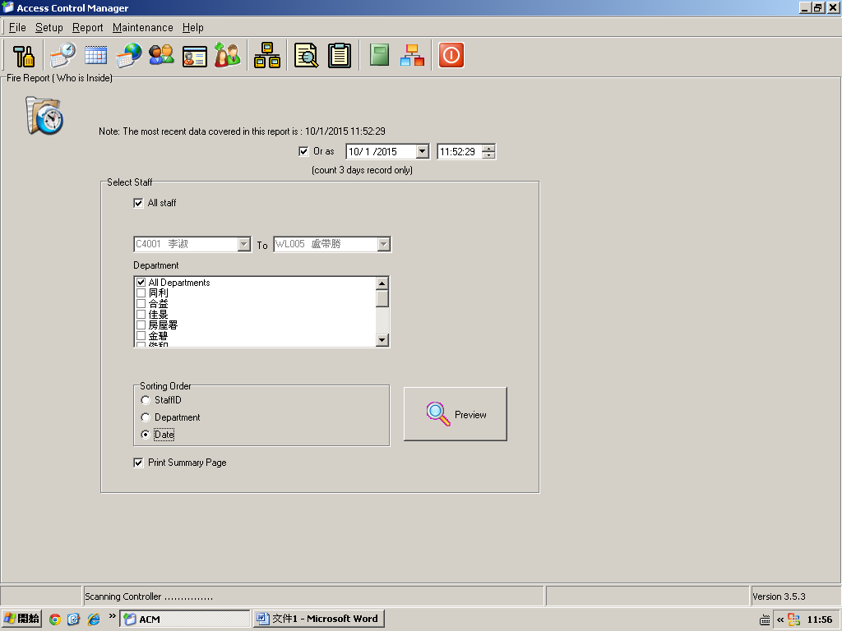
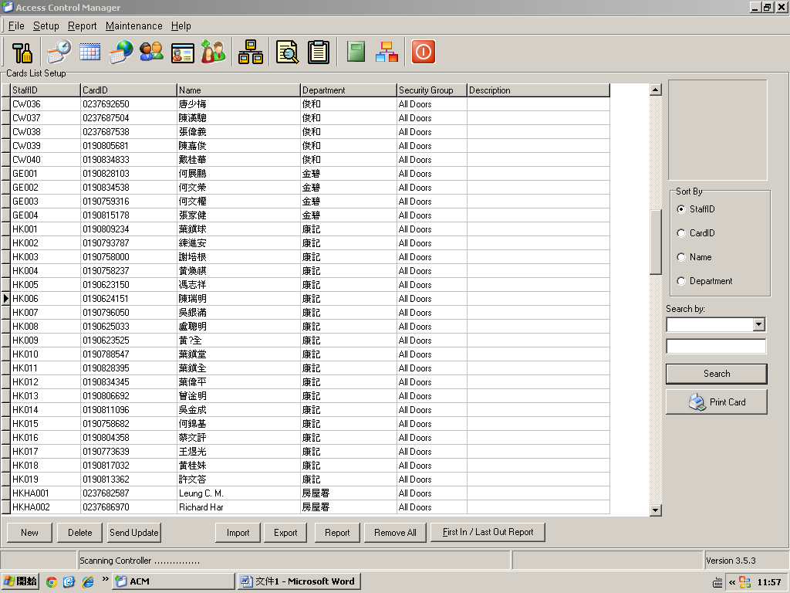
Screenshot 3. Sorting the list of workers according to subcontractors
Screenshot 4. Database of All Workers with RFID Tags

Slide 15
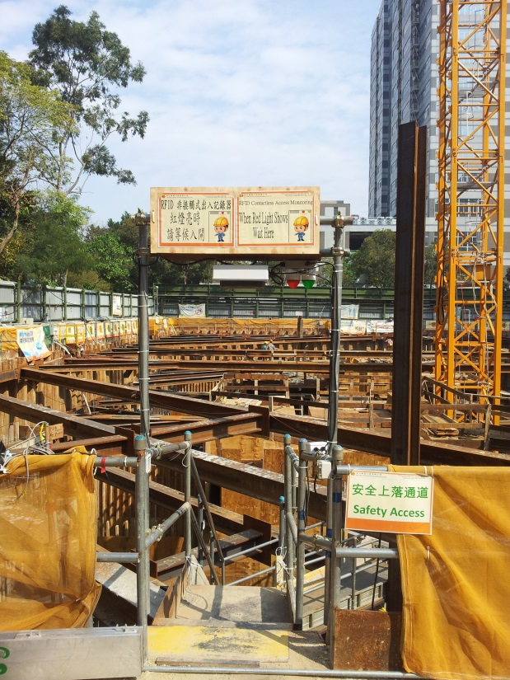
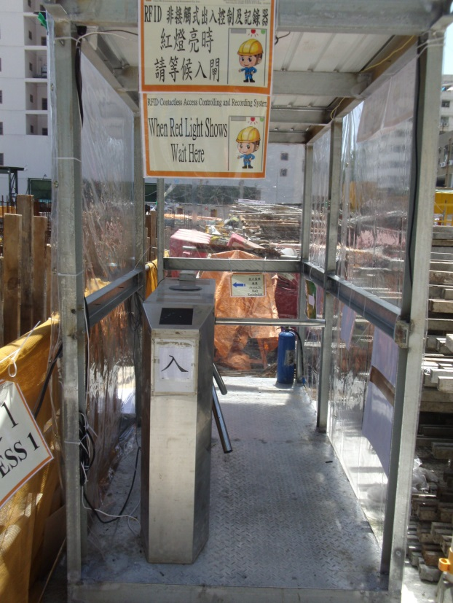
3. Continuous Improvements, Development and Expansion
Improvement 1 since last submission:
Added turnstile to control unauthorized entry

Slide 16
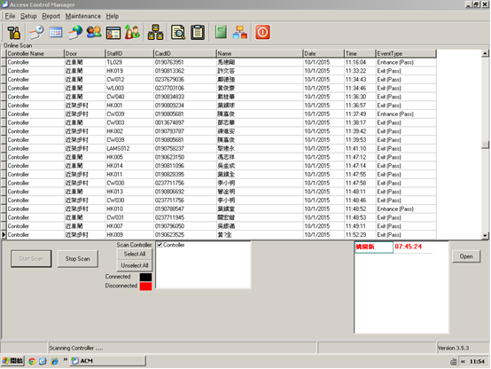
3. Continuous Improvements, Development and Expansion
Improvement 2 since last submission:
Added current list of workers inside workplace with photo

Slide 17
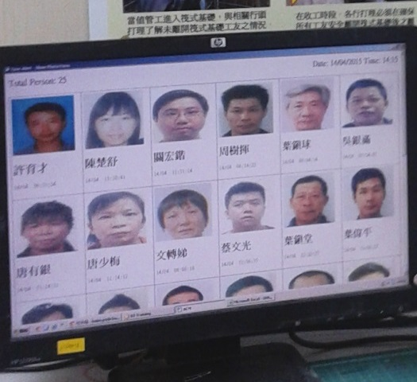
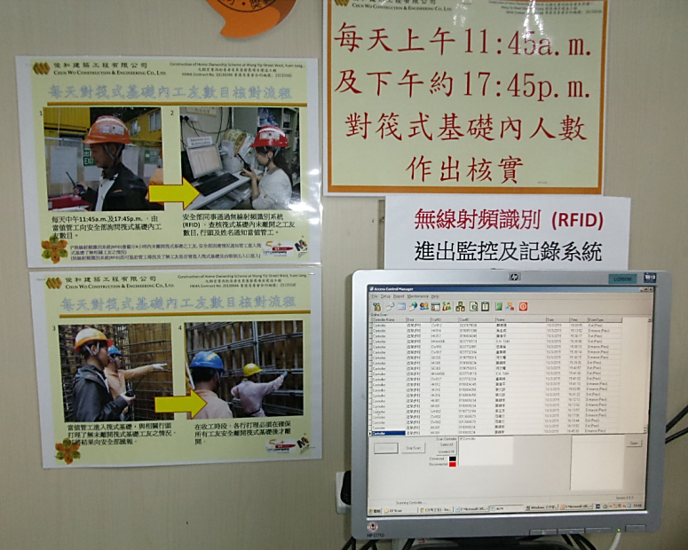
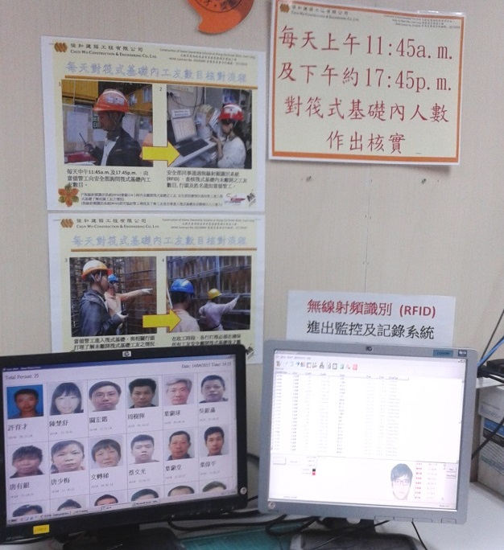
3. Continuous Improvements, Development and Expansion
Improvement 3 since last submission:
Added current list of workers inside workplace with photo

Slide 18
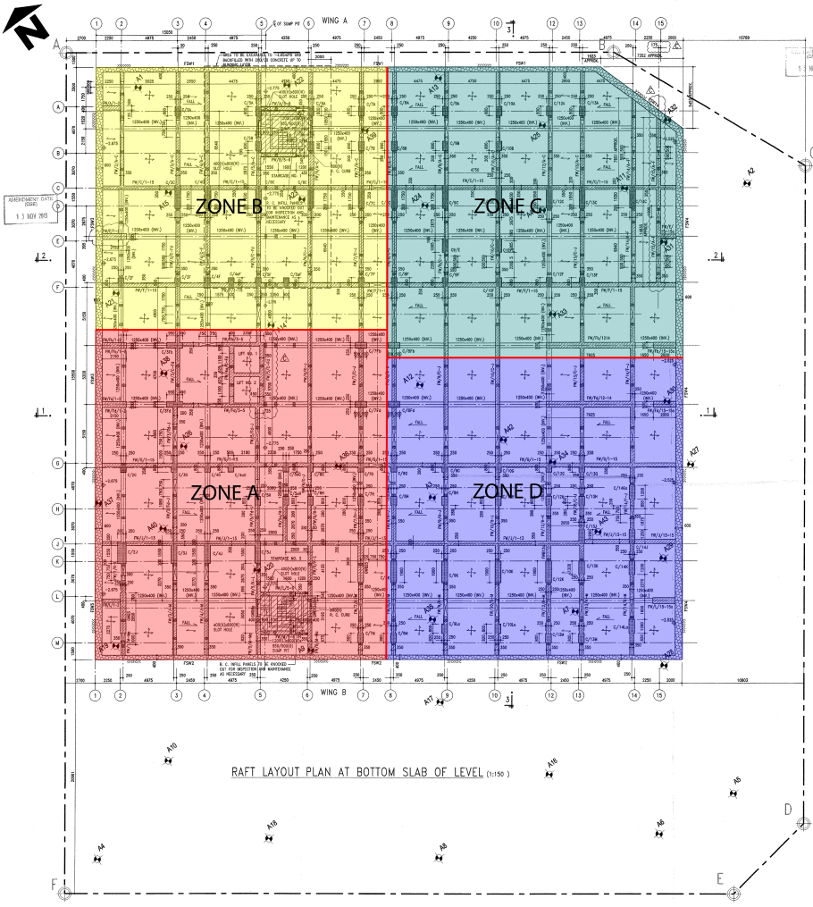
3. Continuous Improvements, Development and Expansion
As out raft foundation is full of buttress wall, it would be difficult to monitor the status of worker within.
We are planning to setting up more RFID receivers to monitor the location of workers within, it will be easier to locate workers inside during emergency situation.

Slide 19
THANK YOU

