Slide 1
Title: Firm Ground Testing Device - Chun Wo Probe Category: Safety Operational Device (Ref No.: C3-007)
Presentation on:
17 April 2015
Chun Wo-CRGL-MBEC
Joint Venture

Slide 2
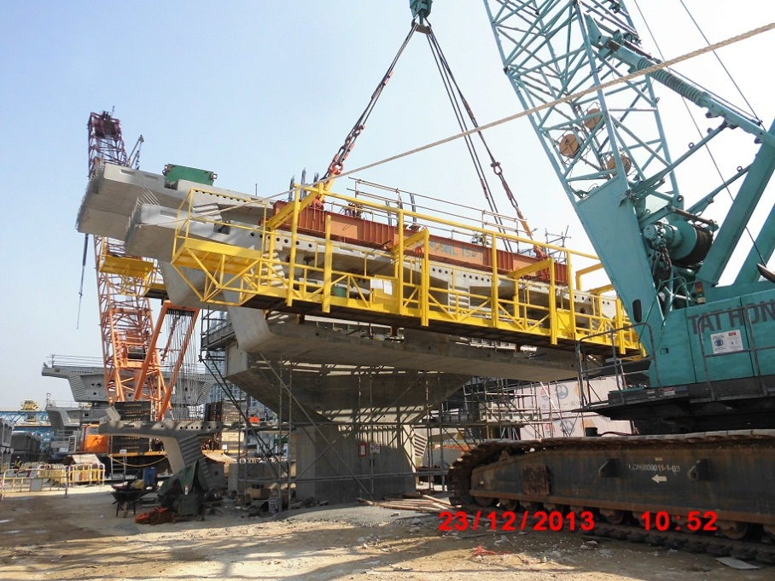
1. Introduction
In view of frequency of crane lorry and mobile crane incidents due to unstable ground conditions in the construction industry.
In this project, there are a lot of heavy lifting operation for bridge works. “Chun Wo Probe” was developed as an easy and fast track field test for font line staff to check ground condition. It is efficient to use. It is light, portable and assembly easily instead of heavy testing machine, so that it can be moved to whole of site by man power.

Slide 3
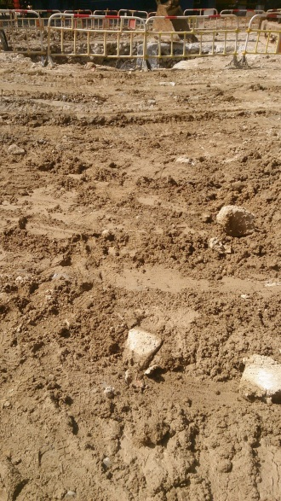
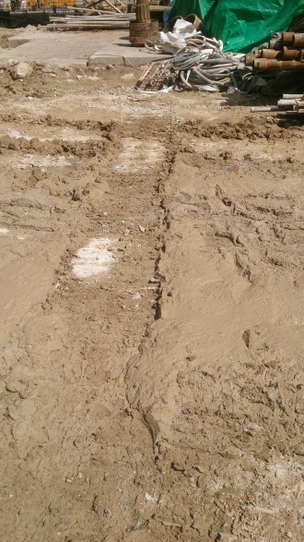
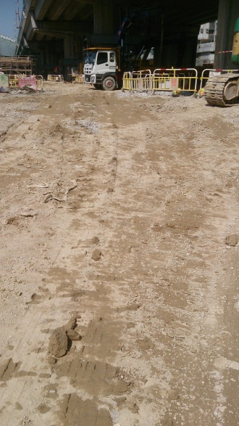
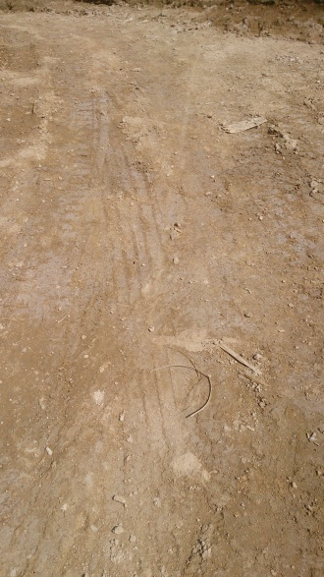
2. Chun Wo Probe Concept
Different soil conditions over the site
Soft Ground
Muddy Ground
Non-compacted Ground
Compacted Ground
Normally, the soil condition is identified by font line staff’s experience. And there is no quick and standard tests to check the soil conditions. Soil properties, such as friction angle, cohesion indicated the soil strength. In those parameters, bearing capacity and relative density are usually used to indicated the soil strength. Plate load test and Standard Penetration Test (SPT) are common tests to determine the bearing capacity and density of soil. However, they required heavy machines. They are not convenient and restricted by site conditions.

Slide 4
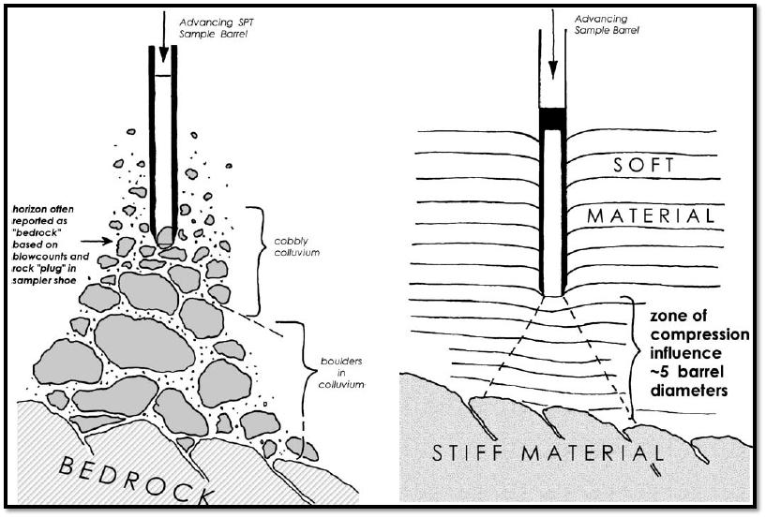
2. Chun Wo Probe Concept
“Chun Wo Probe” was modified from SPT to have a light, portable and easy assembly equipment to check the soil density by the font line staff. This testing combines theoretical and practical knowledge.
It involves driving a probe made of stainless steel rod, into the ground from a slide hammer with standard weight and falling distance.
The probe is driven 300 mm into the ground and then the number of blows needed for the probe to penetrate 300 mm is recorded.

Slide 5
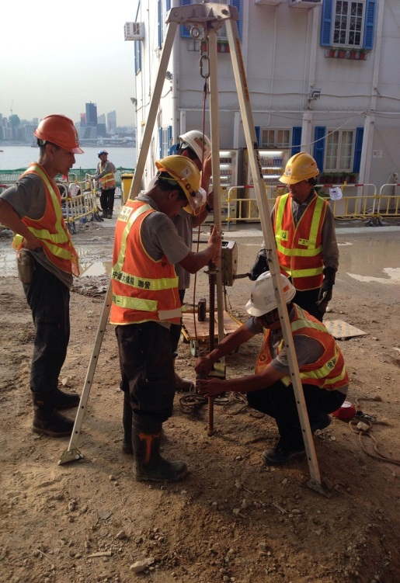
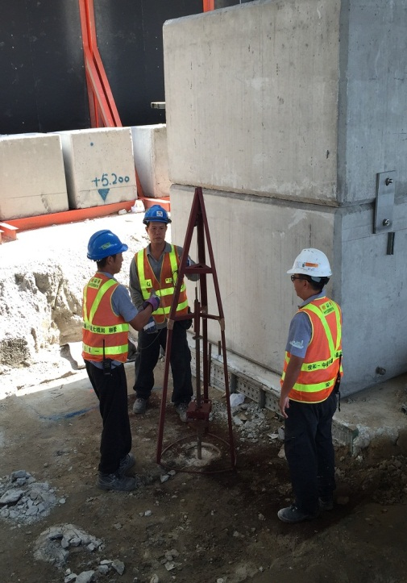
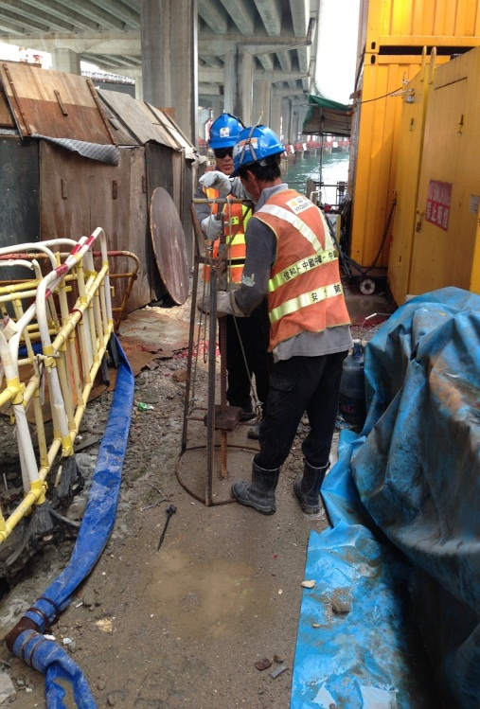
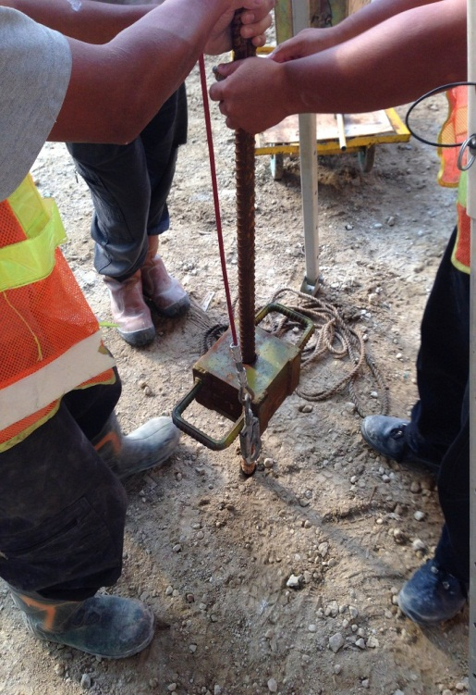
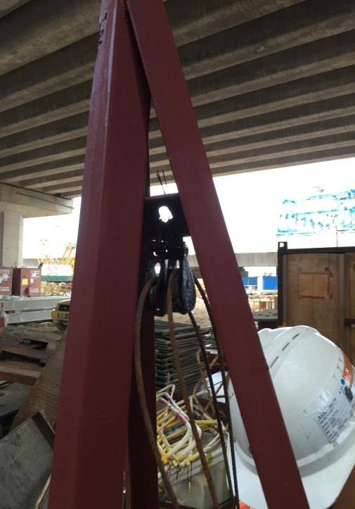
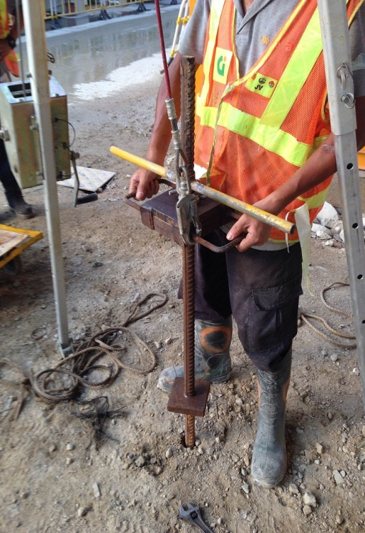
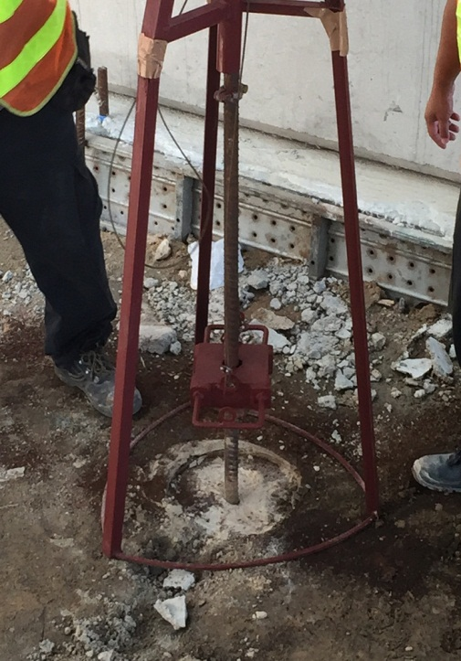
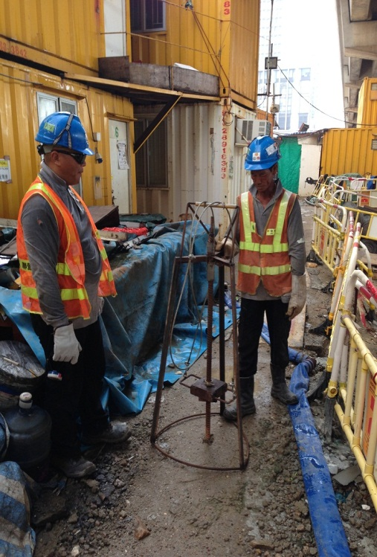
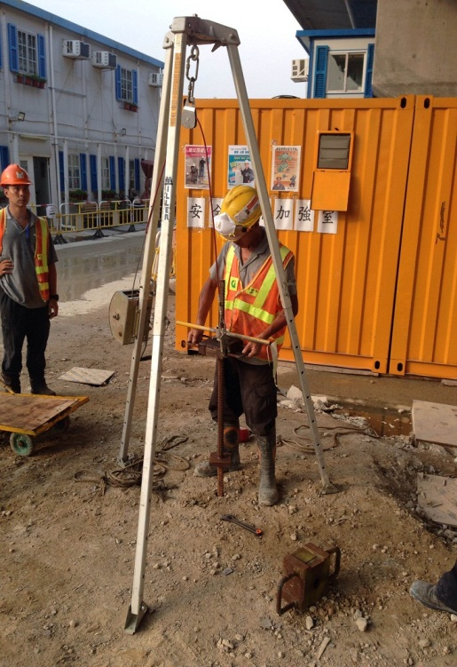
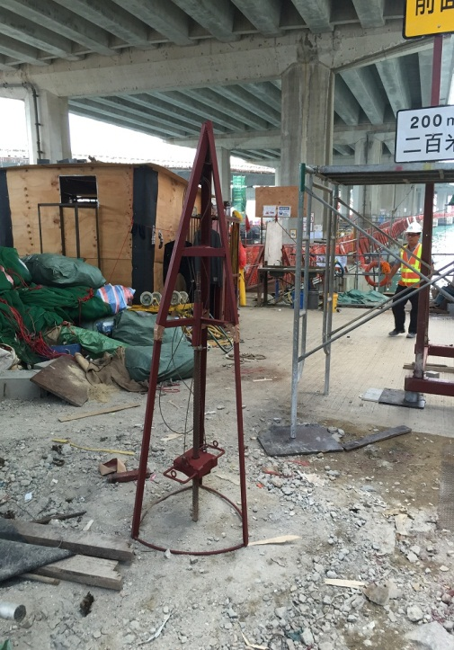
3. Development Process
Initial Product – modified from A Frame. The design direction is good but not function in practical.
“Chun Wo Probe” was optimized by adding pulley and hammer.
The probe was modified to minimized the size and weight to be portable. However, the probe used much man power and was not efficient.

Slide 6
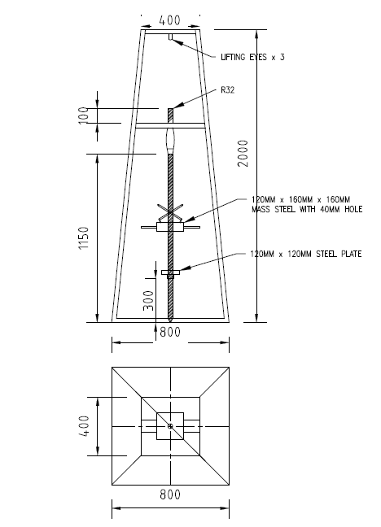
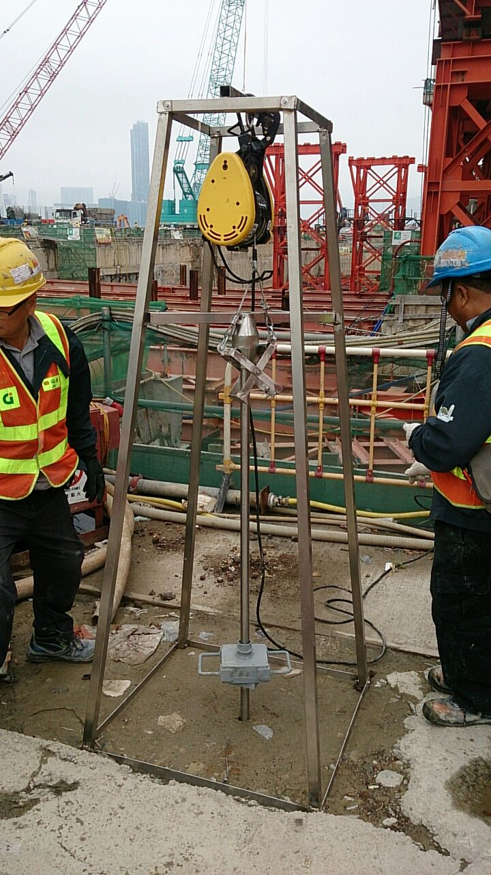
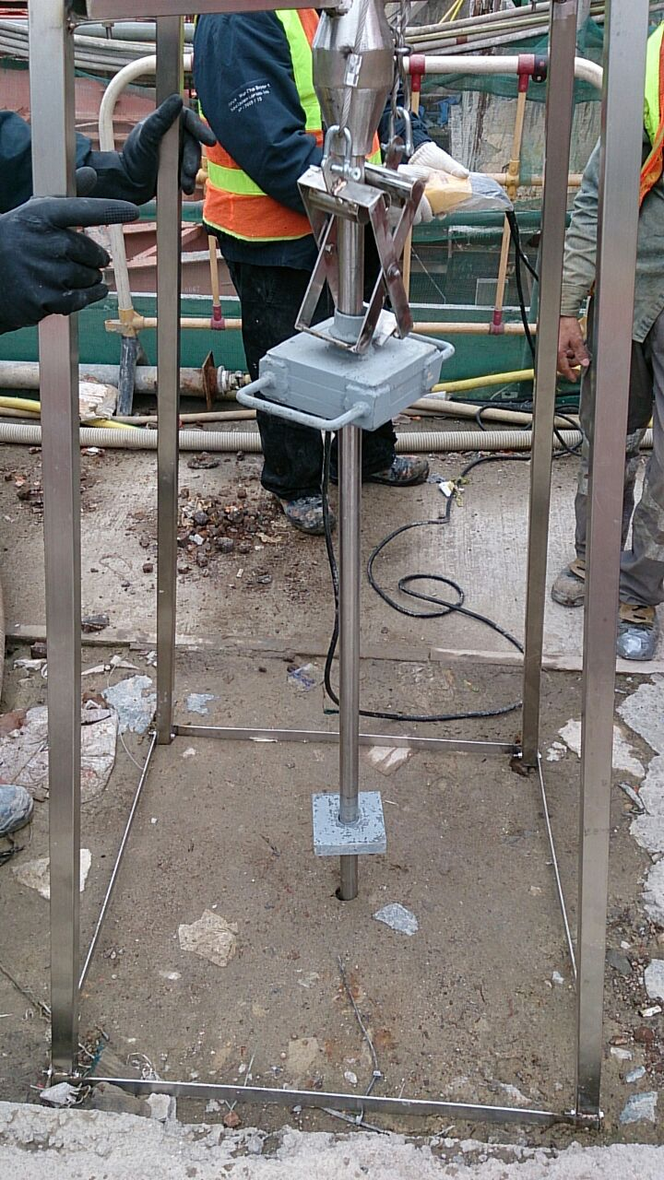
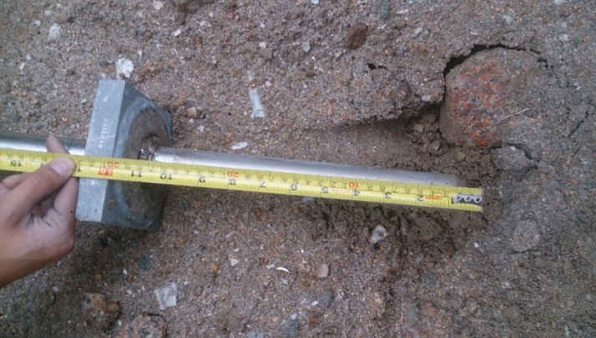
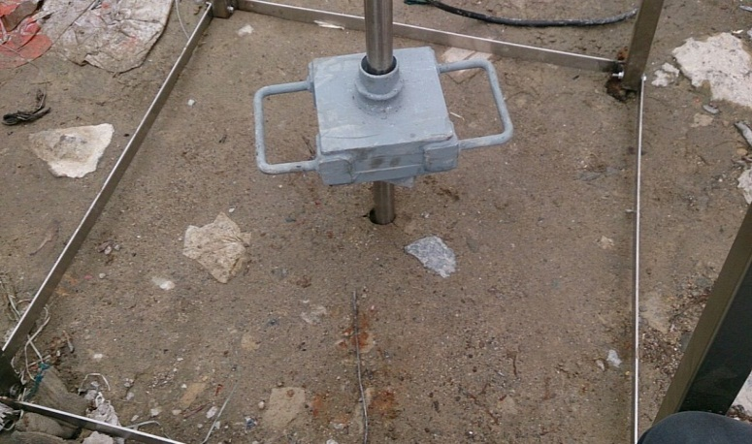
3. Development Process
Winch
The final product:
“Chun Wo Probe” was made of stainless steel. It allows to be stored at bad condition, such as near sea side.
The probe was connected by bolts joints, the assembly will be easier and duration will be minimized.
The winch was added instead of the man power to increase the efficiency.
Bolts joints connection
Hammer
Stainless steel material
Probe

Slide 7
3. Development Process
Video for Assembly
Fast assembly - All the connections of “Chun Wo Probe” are made by bolt joints. The assembly duration is
only 10 mins.

Slide 8
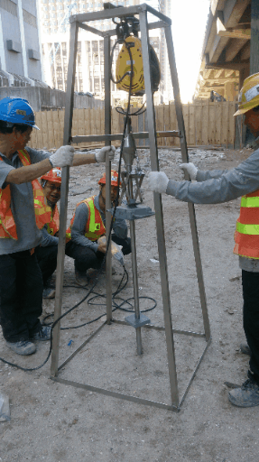
3. Development Process
Video for Operation

Slide 9
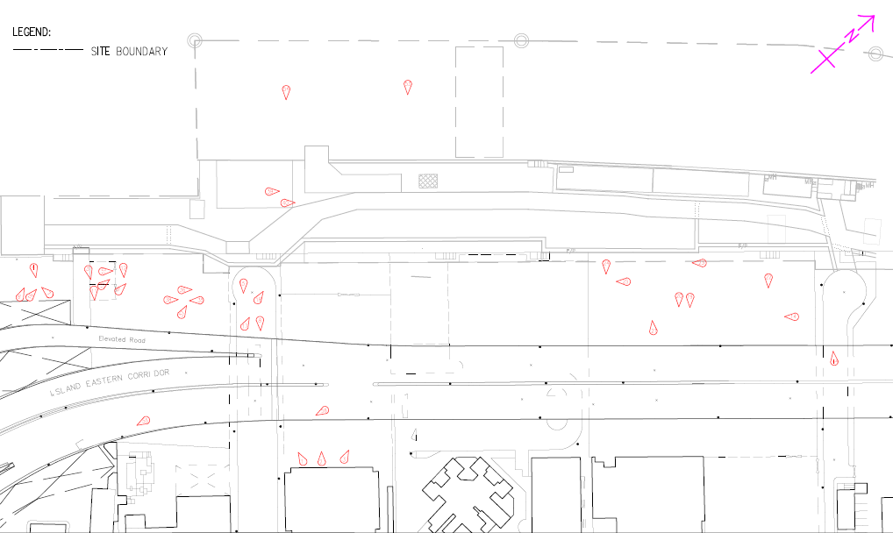
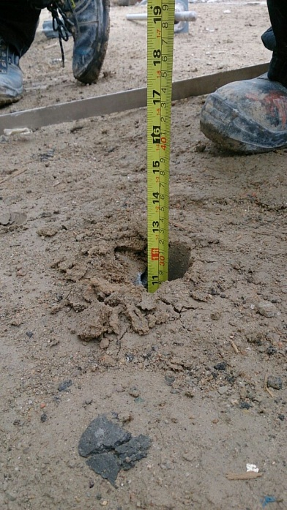
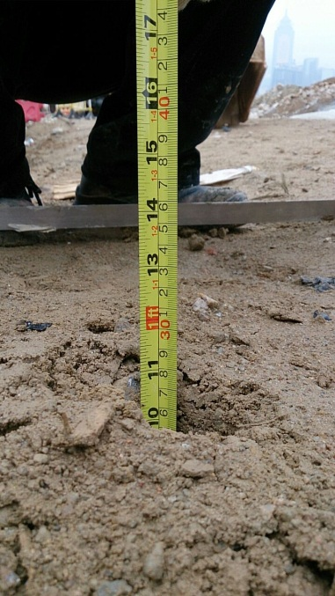
4. Test Location and Results
Test Location
Test3
Test1
Test2
Haul Road, heavy vehicles pass thought for 2 years & 400kPa plate load test passed
common quick backfill/ compact method on site
Haul Road, heavy vehicles pass thought for 2 years

Slide 10
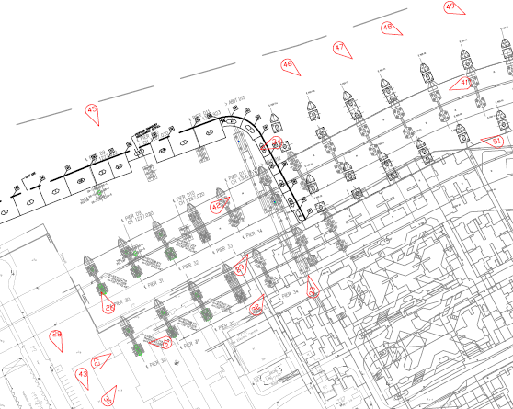
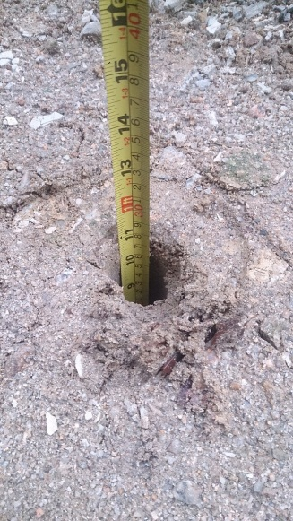
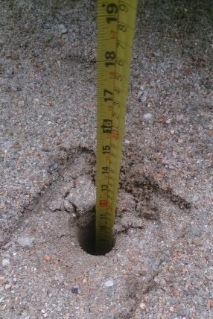
4. Test Location and Results
Test location
Test5
250kPA plate load test (Passed)
Test4
400kPA plate load test (Passed)
Test6
Not compacted

Slide 11
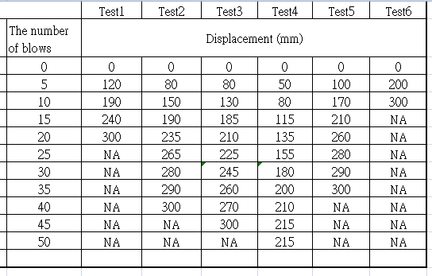
4. Test Location and Results
The number of blows and displacement of the 6 tests were recorded and summarized as above table. The data was developed as a graphical method for font line staff to use.

Slide 12
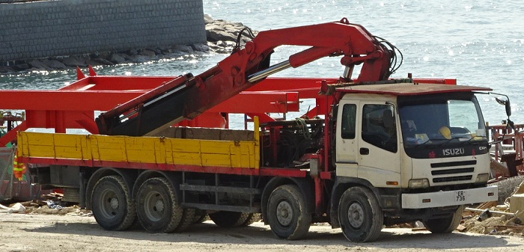
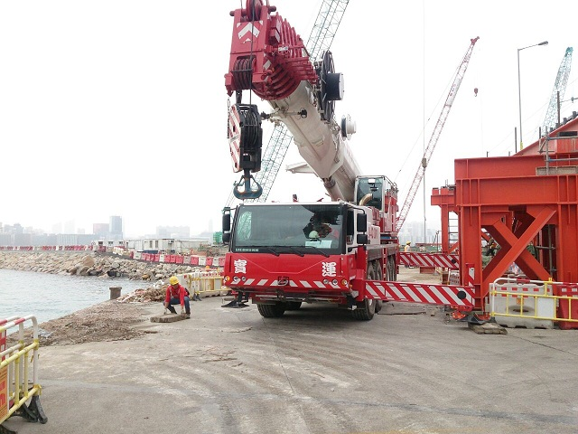
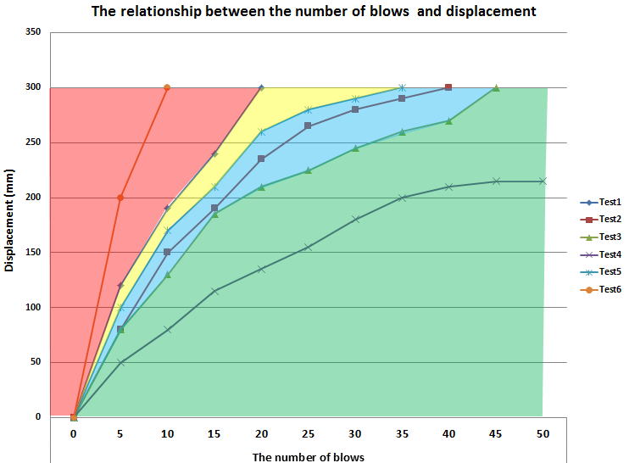
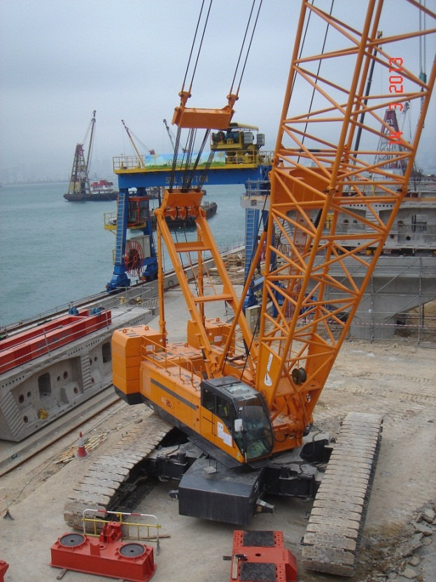
5. Graphical method of “Chun Wo Probe”
Yellow zone representing the soil is suitable for light lifting, such as crane lorry.
This graph showing the soil strength for lifting operations classified by different range of colour.
Red zone representing the soil is not suitable for lifting operation
Blue zone representing the soil is suitable for heavy lifting, such as 100T mobile crane.
Green zone representing the soil is suitable for heavy lifting, such as 300T mobile crane.

Slide 13
Thank You

