Slide 1
Innovative Safety Initiative Award 2015
Safety Operational Device
Material Hoist Supplementary Lock
14 April 2015
Gammon Engineering & Construction Company Limited
J3508 – Redevelopment of Shanghai Commercial Bank

Slide 2
Introduction
Analysis of the past accident related to the use of material hoist is due to:
    Rendering of the interlocking guard
    Person fell into the hoistway as interlocking guard in a well function situation
Contractors with difficulties to further reduce the risk of using material hoist because of:
    Using rental material hoist – implication may caused during return of hoist
    Afraid of large investment cost for enhancement installation
    Lack of skilled and experienced technician for enhancement installation
The supplementary lock designed is trying to resolve the above problems in which the hoist skip can only to open when the skip is at the same level of the landing

Slide 3
Design of
Material Hoist Supplementary Lock
Magnetic Door Lock
Connecting cables
Material Hoist mast
Timer
Material Hoist’s gate
Ordinary interlocking guard
Ordinary interlocking guard:
1. Worker required to get a key to open the padlock first when use.
2. When the rod is pulling away from interlocking guard, the material hoist will be stopped for any movement.
Microswitch
Additional devices required

Slide 4
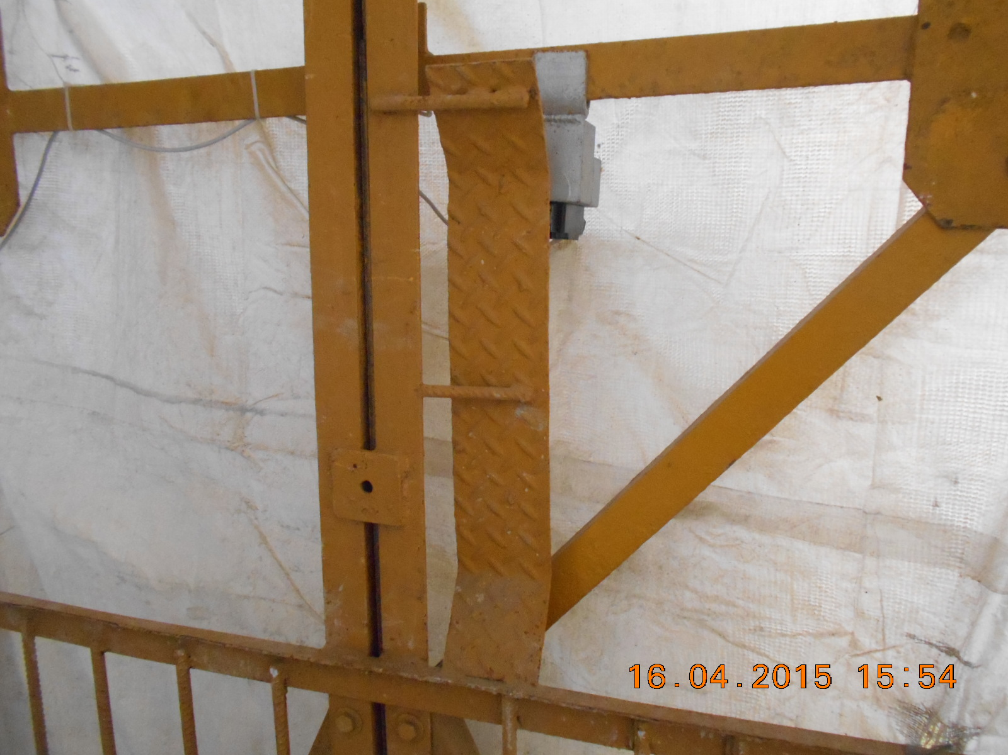
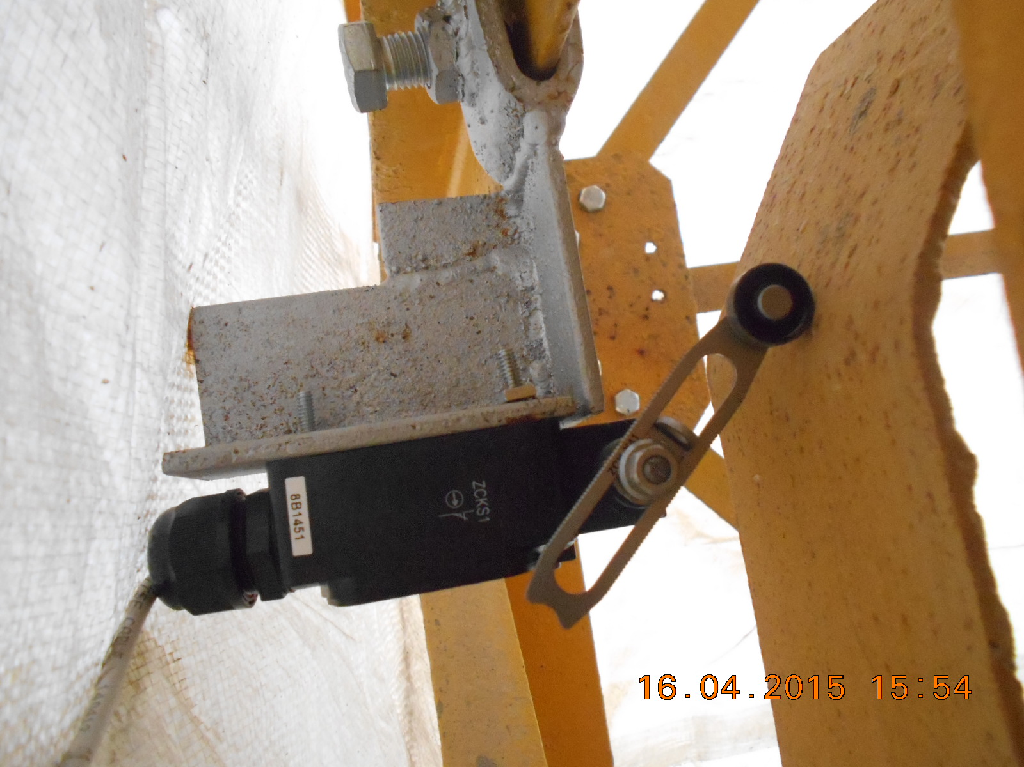
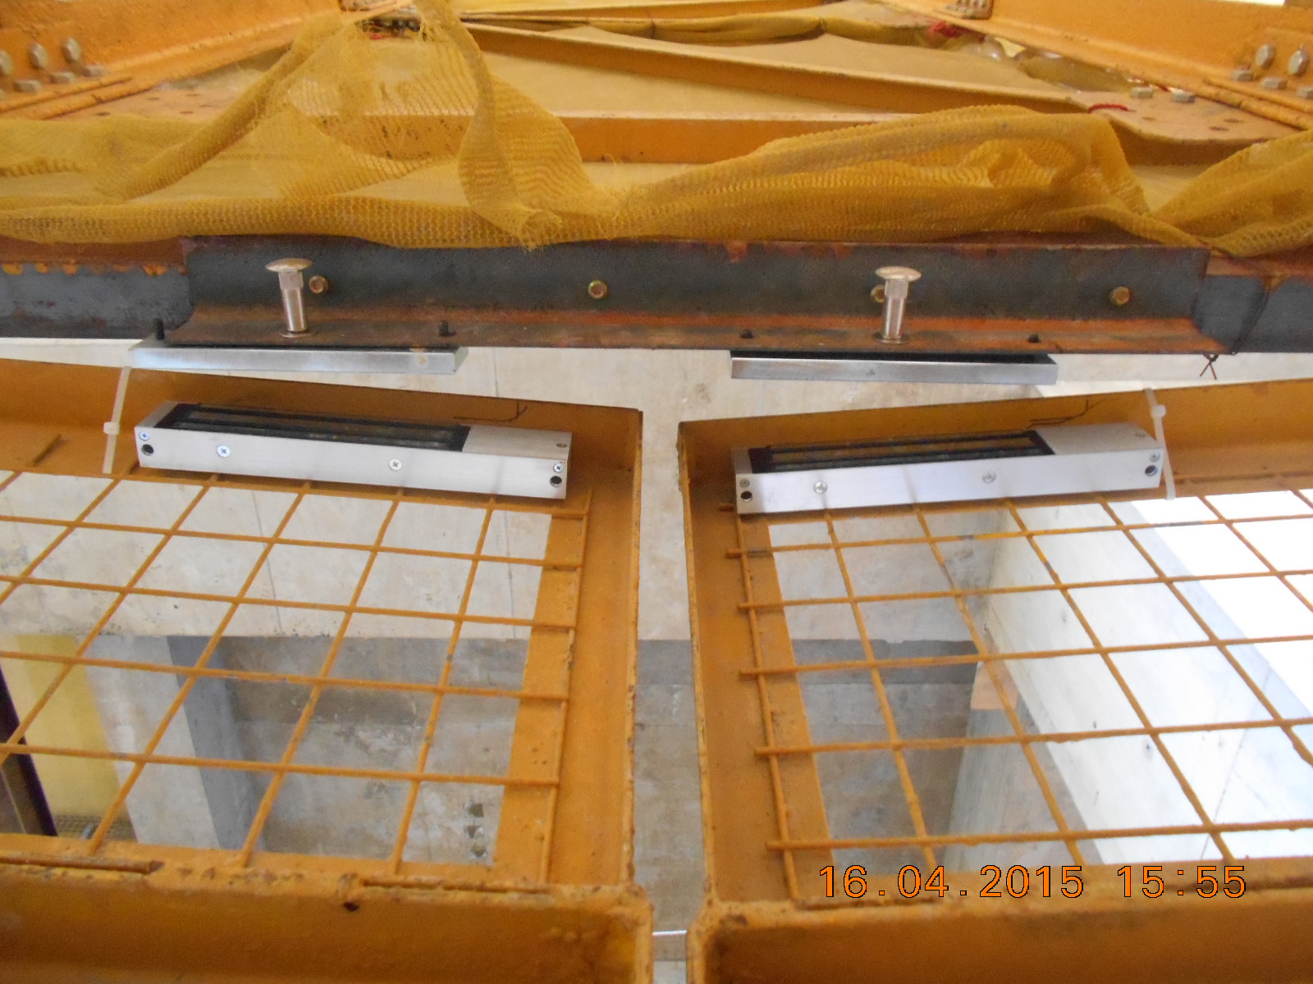

Materials Required
Microswitch
2 Magnetic Door Lock
Timer

Slide 5
Mechanism of
Material Hoist Supplementary Lock
Material Hoist’s skip stopped at landing level
Trigger the microswitch
Signal from microswtich to timer (eg.5s)
Unlock the magnetic lock
Hoist door able to open

Slide 6
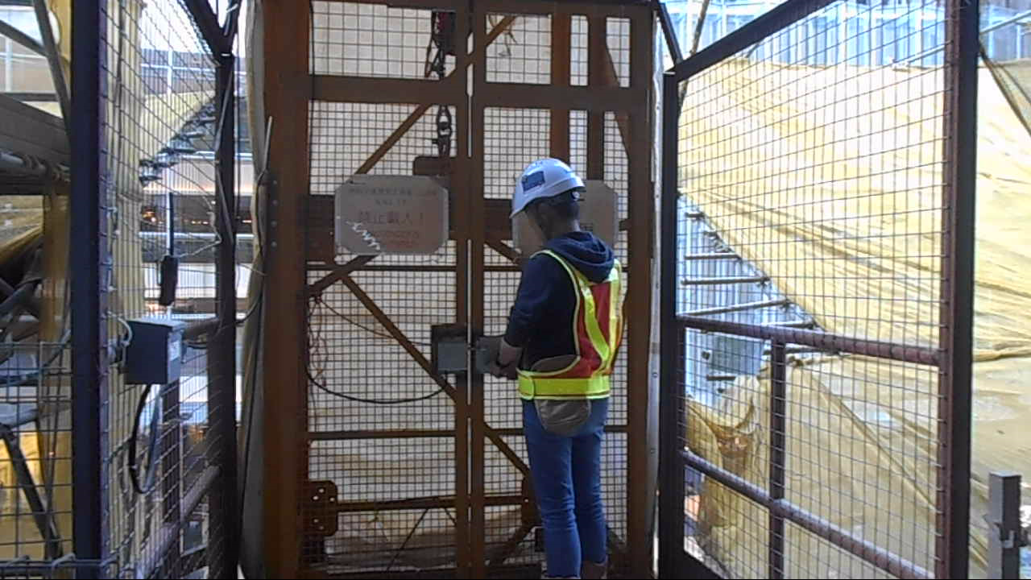
Mechanism of
Material Hoist Supplementary Lock
The hoist door unable to open when the skip of the material hoist is not at the same level of the landing.

Slide 7
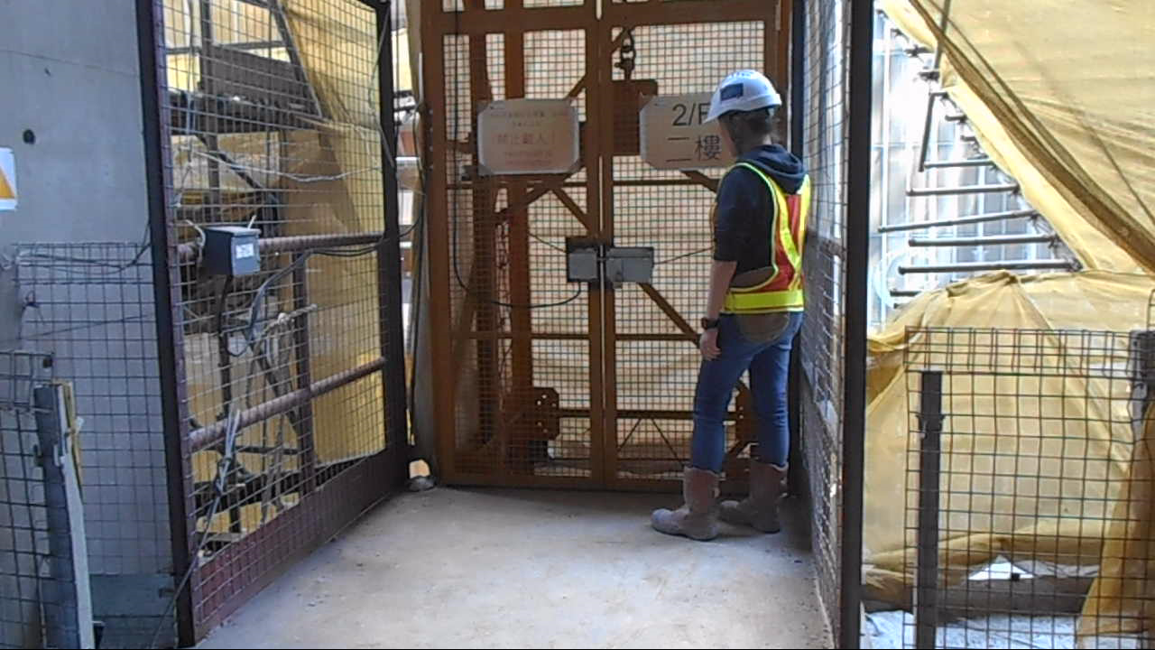
Mechanism of
Material Hoist Supplementary Lock
The hoist door able to open when the skip of the material hoist is at the same level of the landing

Slide 8
End
Thank You

